Slide 1
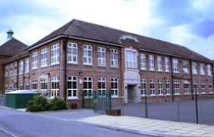
Year 5
2024-2025
Information for parents

Slide 2
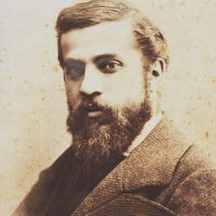
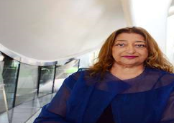
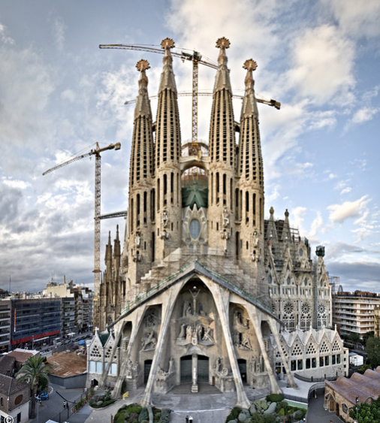
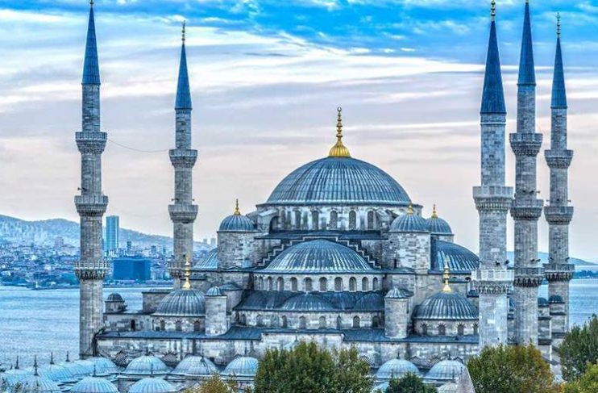
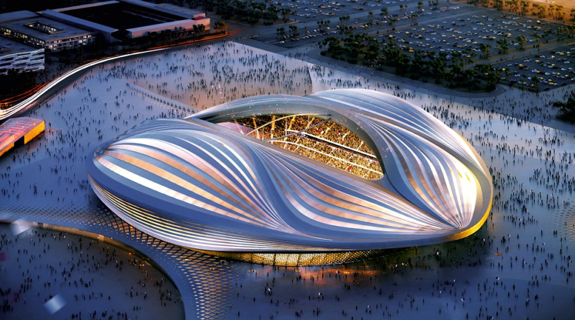
Welcome to Year 5- Famous Architects
Throughout the school year we will be teaching children about the inspiring architects whom our classes are named after.
Children can carry out their own research at home to support their learning.
Mrs Amey Class Gaudi
Mrs Ramesh
Class Hadid

Slide 3
Values
Excellence
Resilience
Our School Values enable pupils to become responsible global citizens.
Integrity
Creativity
Kindness

Slide 4
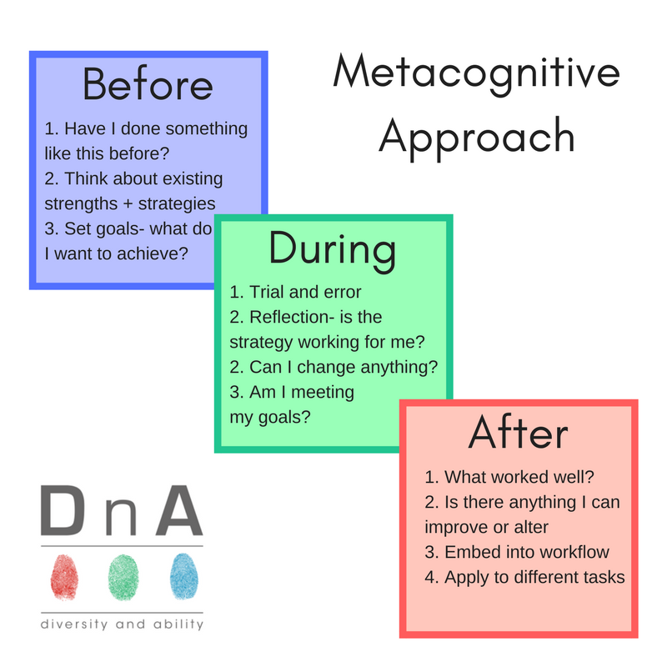
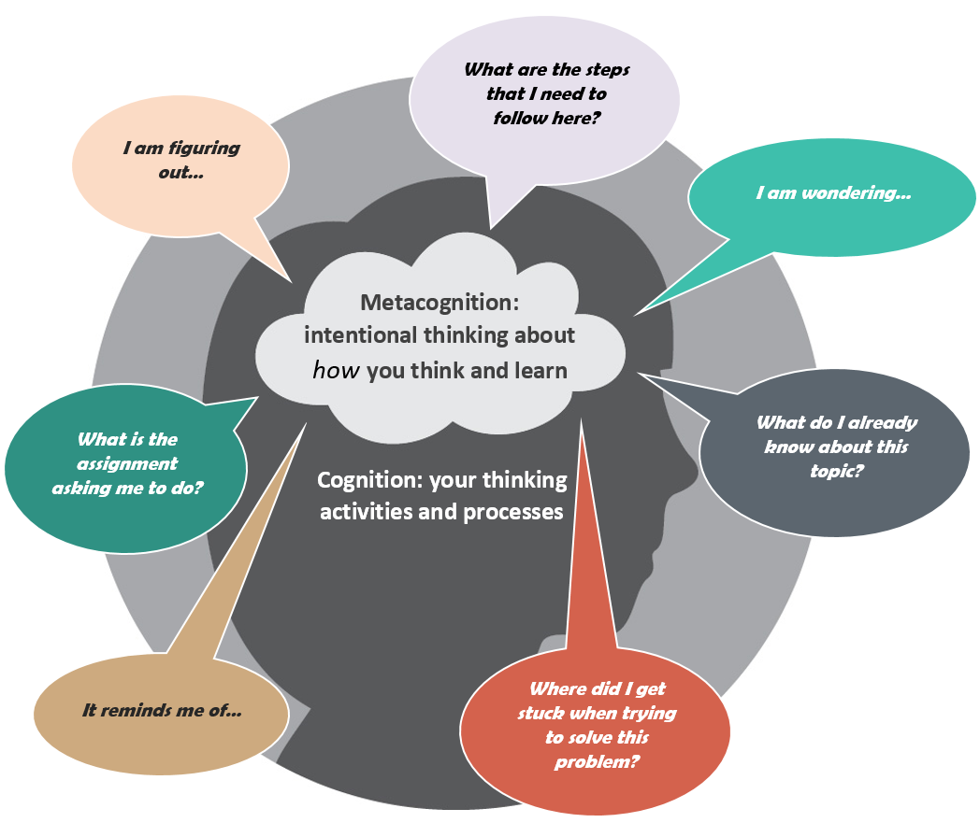
Metacognition
It allows children to become ACTIVE and REFLECTIVE learners.
You will hear children using phrases such as ‘Power of Yet!’ or ‘Mistakes are Good!’
Please encourage them to describe their learning journeys at home as well.

Slide 5
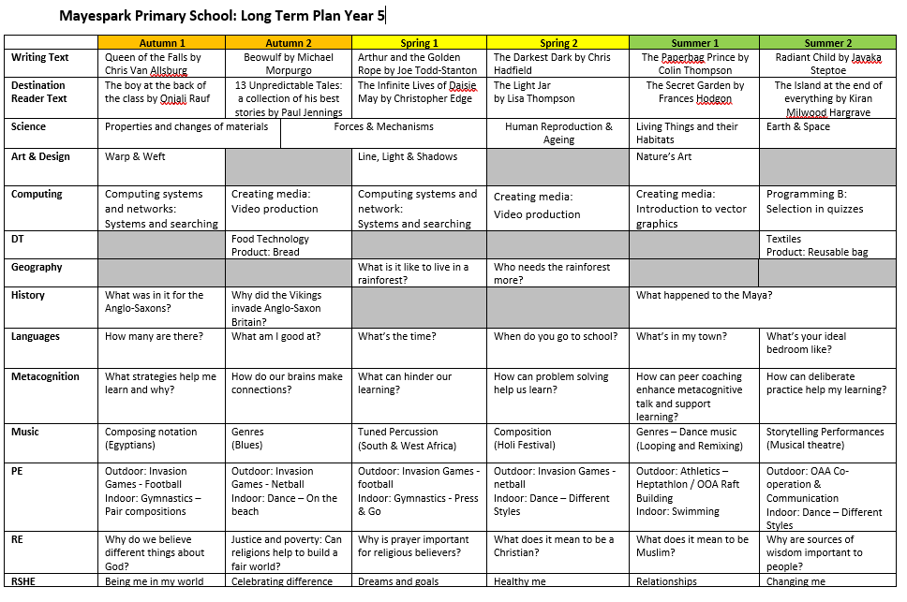
Curriculum
The long term plan for year 5 can be found on the school website.

Slide 6
Curriculum
Every half term you will receive an overview of what your child will be learning at school.
You may wish to support your child by taking them to the local library to do their own research on some of the topics we will be covering.

Slide 7
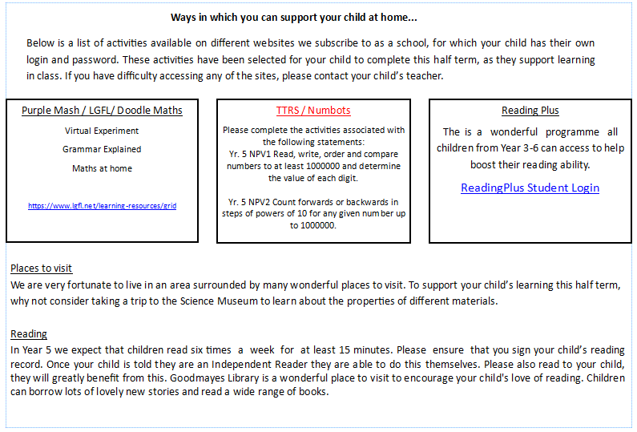
Parental Involvement
Reading
A list of ways you can support your child with their learning will also be sent home every half term.

Slide 8
Reading expectations
Children will bring home two books;
One book will be appropriate to their reading level and they will be able to read this independently.
The other book will be from the book corner that you can share and read together.

Slide 9
Twice a half term, we will also visit the Goodmayes Library to gain access to a wider range of books. You can also visit the library in the evenings and during the holidays.

Slide 10
We will share children’s targets with them during the first few weeks. Please discuss the concepts and strategies shared in the Big Picture.
Maths in Year 5

Slide 11
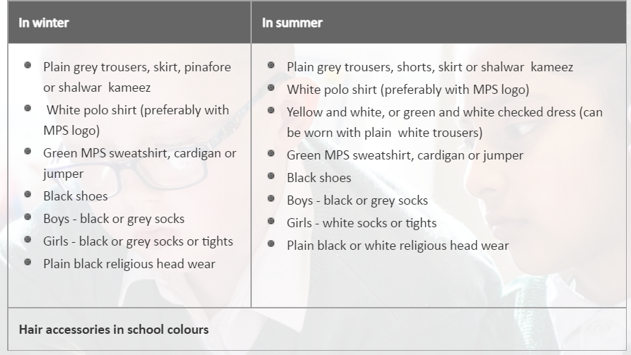
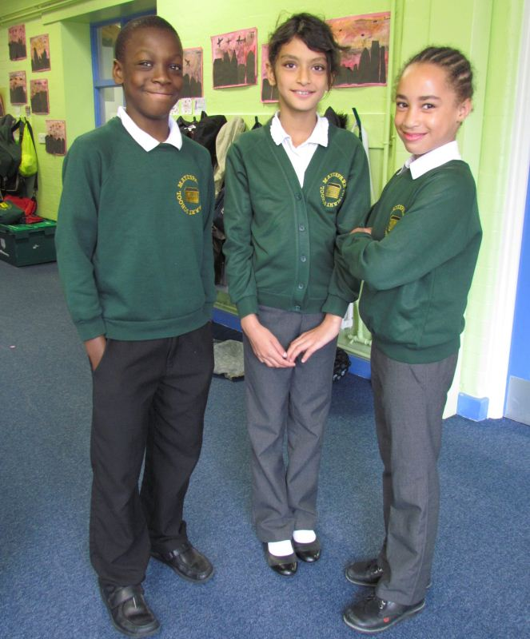
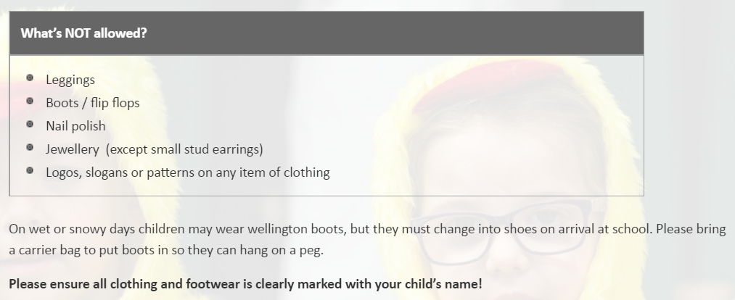
We will share children’s targets with them during these first few weeks. Please discuss the concepts and strategies shared in the Big Picture.
Uniform

Slide 12
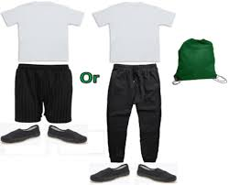
PE Kits
PE kits will remain in school and be sent home to be washed regularly.

Slide 13
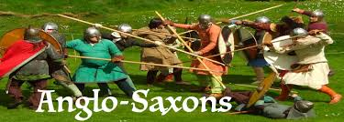
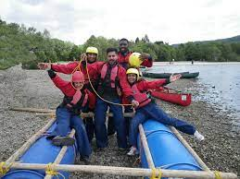
Educational Visits and Events
Our aim is for your child to take part in at least one educational experience each half term

Slide 14
Homework
Homework is set on Google Classroom. Each child has a log in and can be found in the back of their reading records but please ask your child’s class teacher if you don’t have one.
Where possible, homework is linked to the learning that has already happened in the week gone by or will happen in the following week.
Homework is set on a Friday, children are encouraged to work independently to complete the given tasks in their CGP books and hand it in by the following Thursday.
A spelling test will be on Friday and new spellings will be sent home.

Slide 15
Communication
Please do not hesitate to contact us in person by making an appointment out of teaching hours or through the school office via phone call or email.
Phone: 02085992263 (please leave a message and we will return your call out of teaching hours)
EMAIL: office@mayespark.redbridge.sch.uk
We look forward to your support and cooperation in making this academic year a memorable and successful experience for your child.

Slide 16
Finally
Year 5 is going to be a great year. We cannot wait to start our learning journey together with your children. We know there are lots of things to remember and it will be very busy, full of new learning, but we will have lots of fun and laughs along the way! If you have any further questions, please speak to your child’s class teacher. Year 5 Team☺

