Slide 2
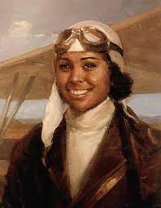
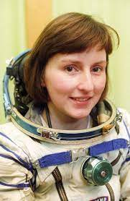
Bessie Coleman | Helen Sharman | Mae Jemison
Miss Roult (Year Group Leader) Miss Rouf (Fridays) | Miss Ahmed | Miss Lewis
We will teach the children about the inspiring personalities our classes are named after, we are sure they will be excited to share this information with you.

Slide 3
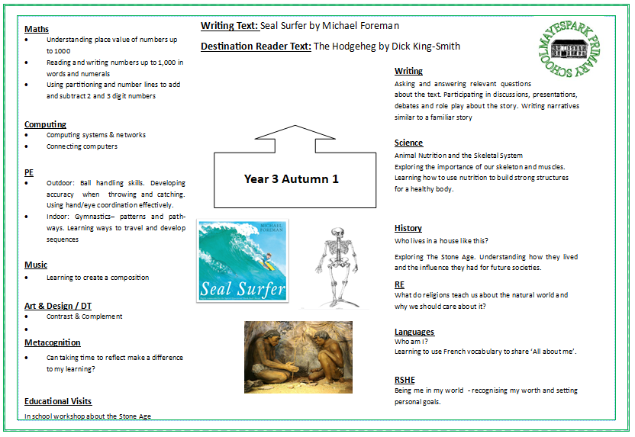
Curriculum
Every half term, you will receive a curriculum map, outlining all the subjects and topics being taught in that term. Please check your emails and MySchool App for latest updates.
You will also find these maps on our school website.
https://www.mayesparkprimaryschool.org.uk/Long-Term-Annual-Curriculum-Maps/

Slide 4
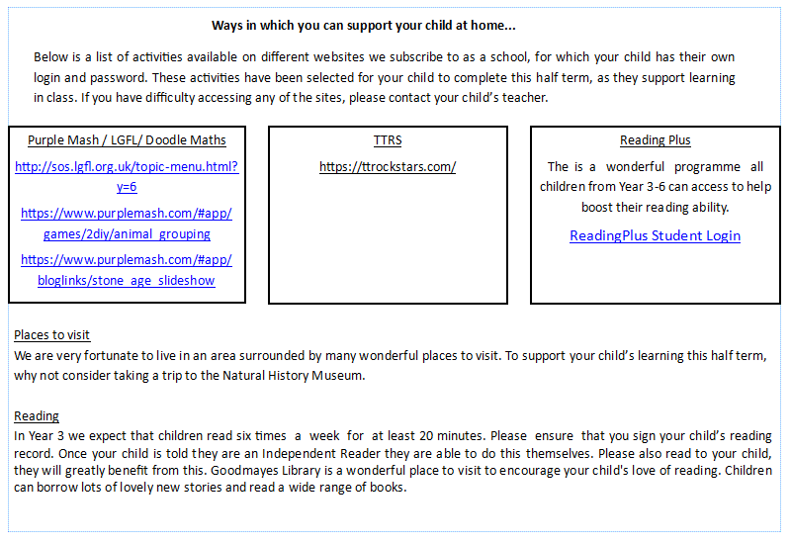
Parental Involvement

Slide 5
Reading in Year 3
Every child in Year 3 is expected to read at home with/ or to an adult for at least 20 minutes daily, followed by a brief discussion about what they have read.
This reading and discussion should then be recorded in their reading records by parents every day. (Please ensure your child read their school banded book) It is expected that parents must sign the reading record every day.
Reading records are checked by an adult in school every day.
Your child will bring home 1 colour banded book. They are able to change this whenever they need as they come into school in the morning.
Your child’s reading TARGET has been added to their reading record, please refer to these when reading with your child.
Reading Records will be checked in class every day.

Slide 6
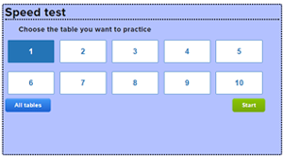
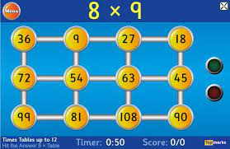
Maths in Year 3
How can you support?
In year 3, you can support your child in Maths by completing the homework, accessed via Google Classroom.
Additionally, you can also access various apps/games which we use in school such as: Hit the Button, Times Table Rockstars and DoodleMaths.
https://www.splashlearn.com/times-tables-games
https://www.ictgames.com/
https://mathsframe.co.uk/en/resources/category/22/most-popular
https://mathszone.co.uk/category/number-facts-x%C3%B7/all-tables-choosable/

Slide 7
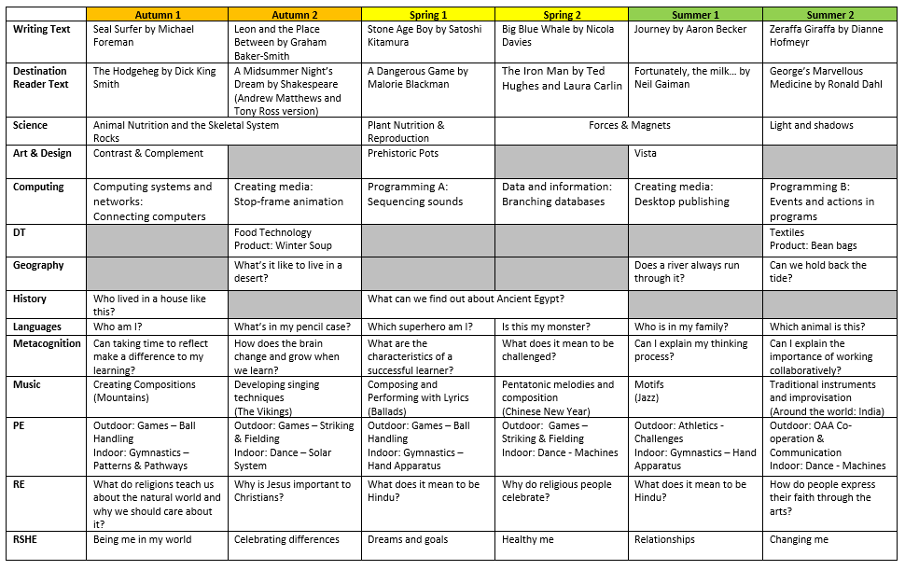
Topics

Slide 8
Homework
Weekly homework will be set and shared on Google Classrooms every Friday by 4pm.
Children will be expected to complete in their homework books which will need to be handed into their teacher by the next Wednesday.
What we expect from your child
It is important that your child engages with home learning so they complete the work teachers are setting online and upload it so it can be checked before the next piece of work is set.
Becoming responsible for their own learning is a key area for development this year.
https://www.mayesparkprimaryschool.org.uk/Google-Classroom/

Slide 9
Spellings
Weekly spellings will be sent home every Friday, children are expected to practise these daily by using LOOK, COVER, WRITE and CHECK strategy.
Each week, there will be a spelling test on Friday.

Slide 10
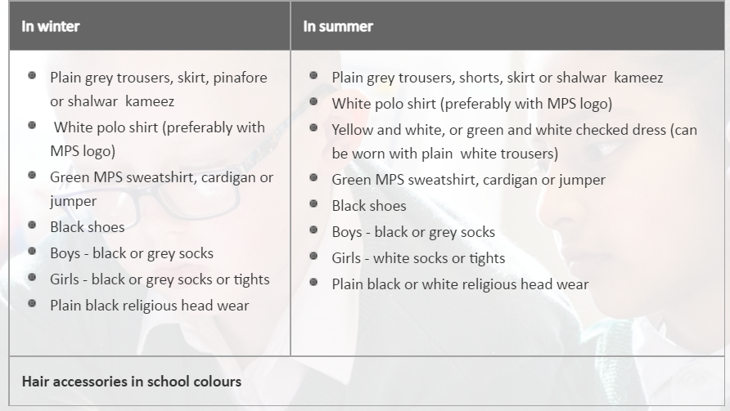
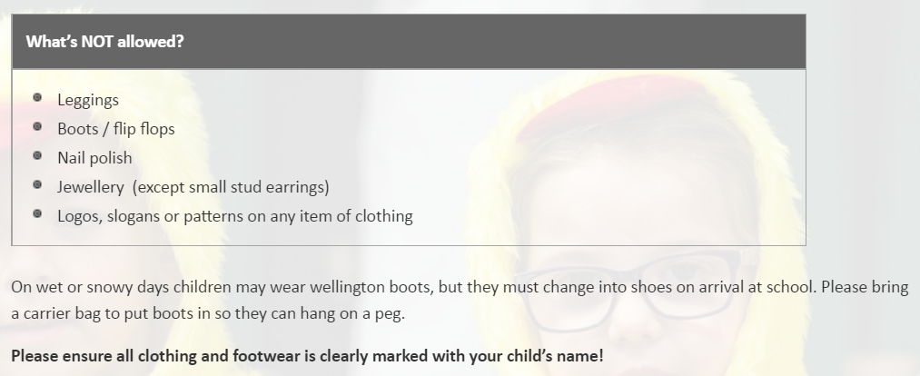
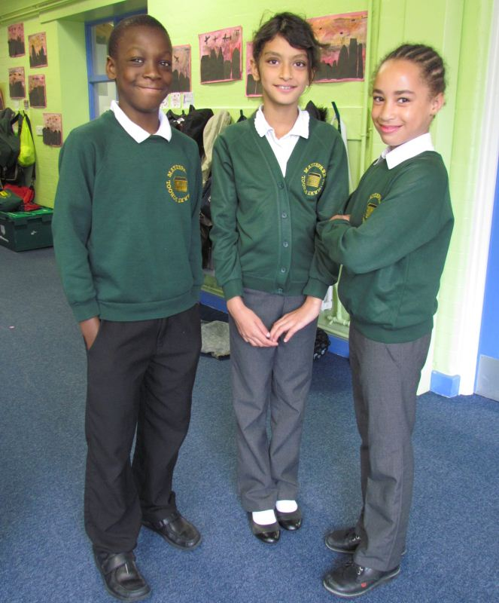
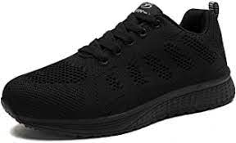
Uniform Expectations
https://www.mayesparkprimaryschool.org.uk/Parents/Uniform/

Slide 11
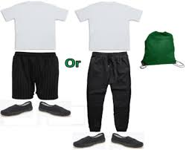
PE Lessons
PE kits will remain in school and sent home to be washed in the holidays.
Please label all your child’s belongings clearly.

Slide 12
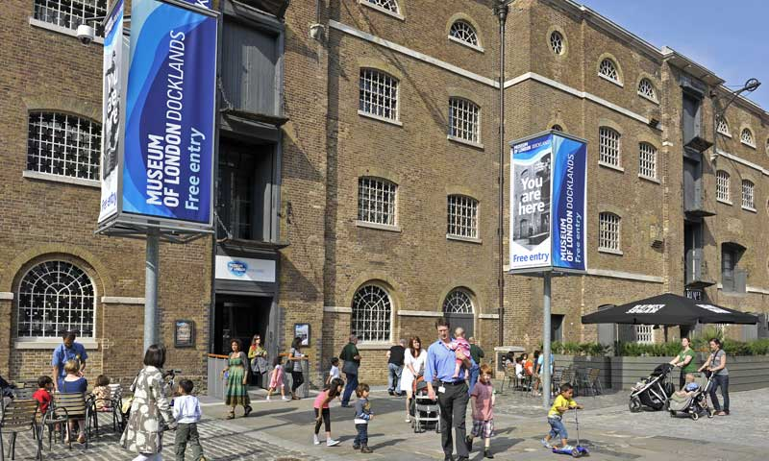
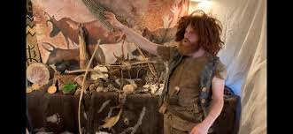
Events in Year 3
This year we are hoping to organise interesting school events. We are looking forward to taking children out on visits and also to have visitors in school to make our topics fun and exciting.
If you would like to accompany us as a volunteer on any of the visits, please inform your child’s class teacher.

Slide 13
Communication
Please do not hesitate to contact us in person by making an appointment through the school office via phone call or email.
Phone: 02085992263 (please leave a message and we will return your call as soon as possible)
EMAIL: office@mayespark.redbridge.sch.uk
We look forward to your support and cooperation in making this academic year a memorable and successful experience for the children.

