Slide 1
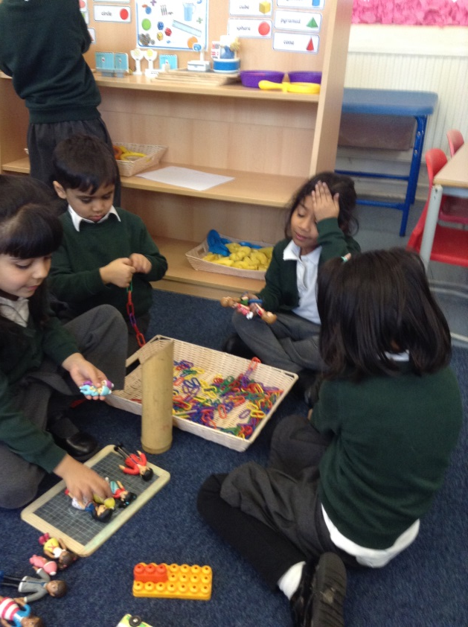
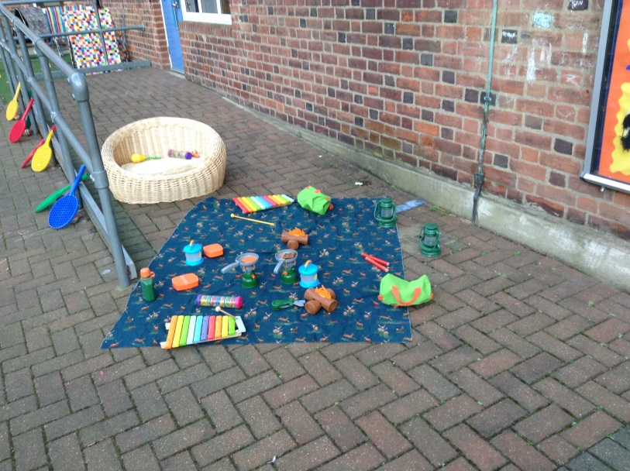
Welcome to Reception

Slide 2
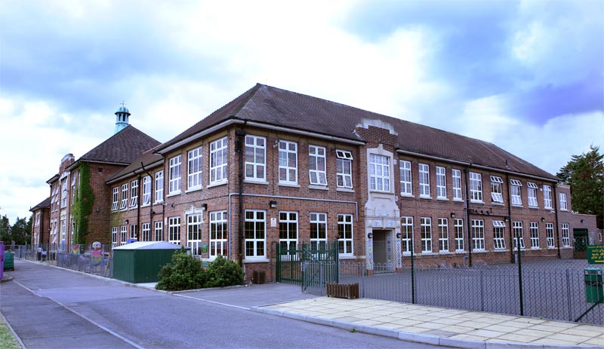
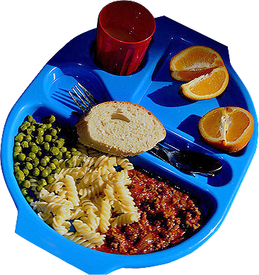
My school day
The doors open at 8:55am
and school starts at 9.00am
You will have lunch at 11.45am
You will go home at 3.15pm

Slide 3
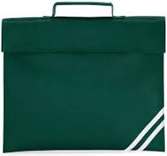
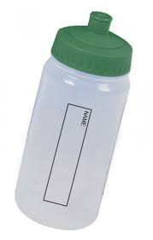
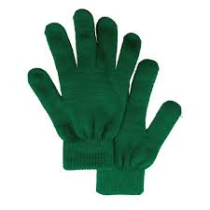
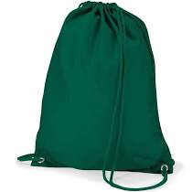
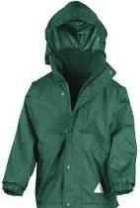
What do I need to bring?
A book bag
A PE bag with your name on
A water bottle with your name on
A sun hat for the summer
Gloves and a coat for the winter

Slide 4
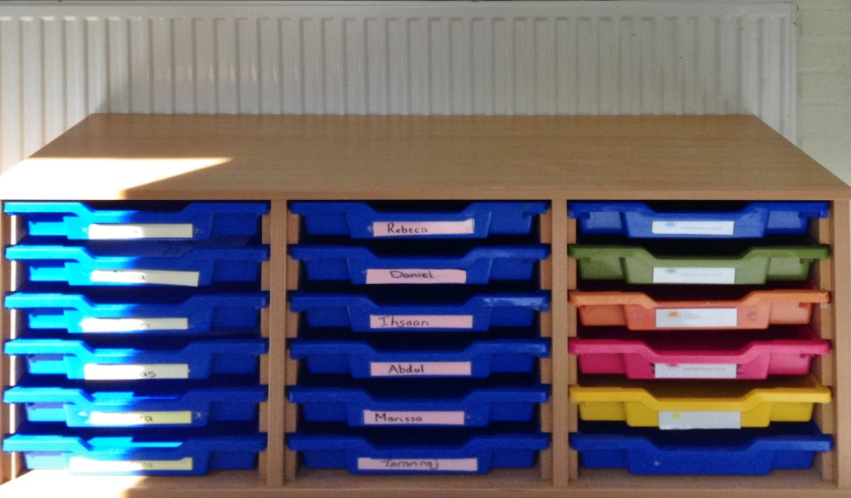
My first day at school
You will enter school through your classroom door
The adults will show you your
own peg to hang your coat on.
You will put your book bag into your tray.

Slide 5
Kahlo
Your class is called Kahlo and this is your class teacher. .
Miss Nour
EYFS Leader

Slide 6
Kapoor
Your class is called Kapoor and this is your class teacher.
Mrs Bhogal
Class Teacher

Slide 7
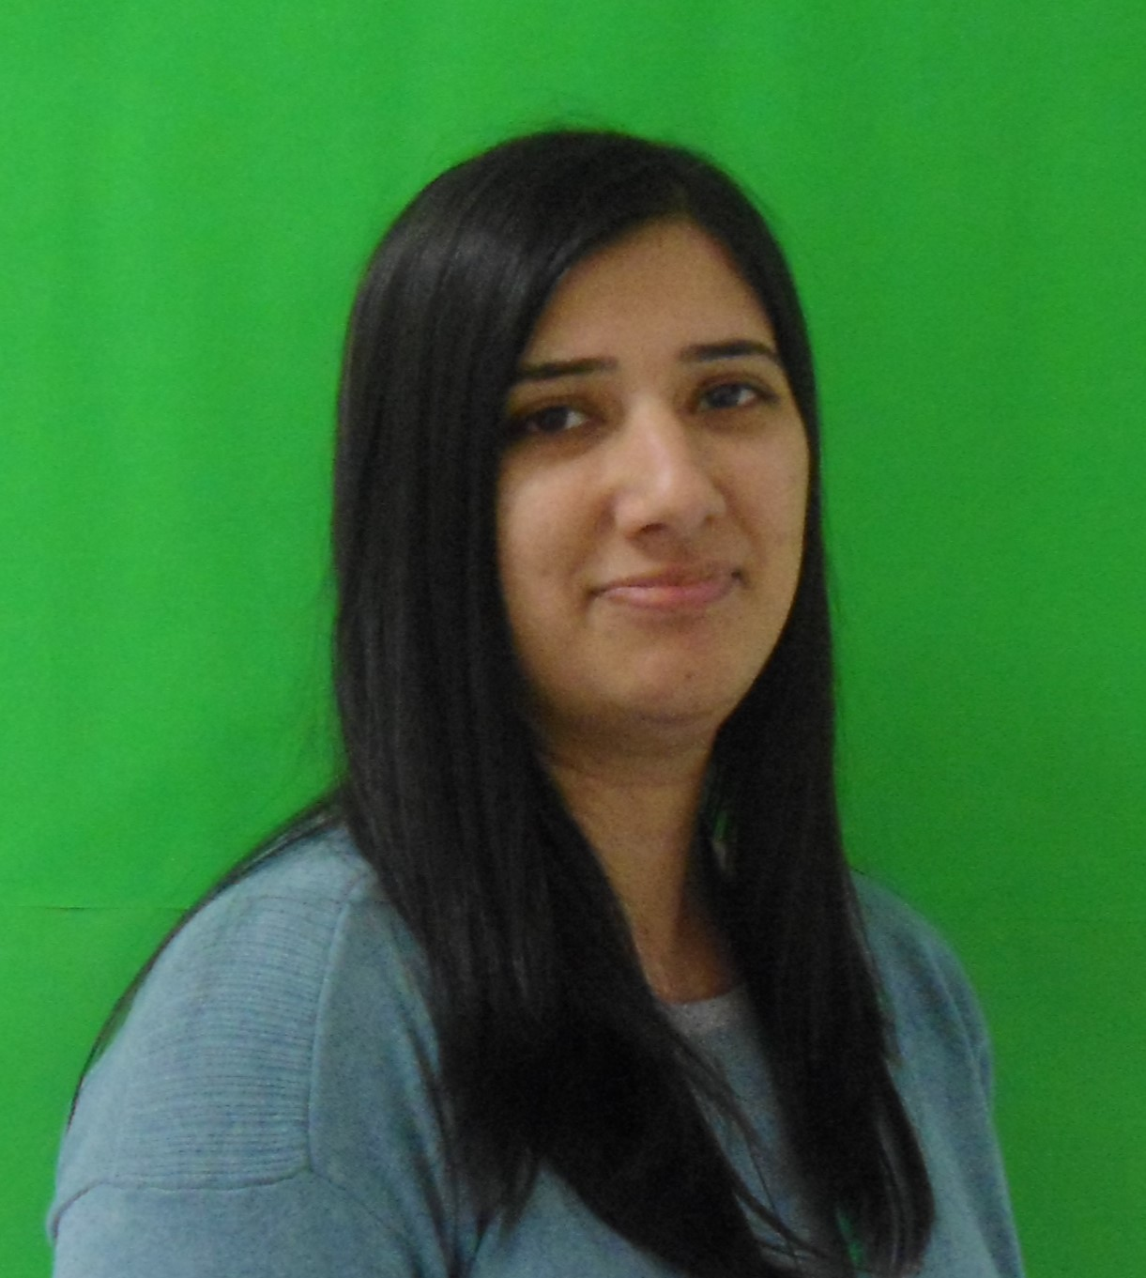
Carle
Your class is called Carle and this is your class teacher.
Miss Ahmed
Class Teacher

Slide 8
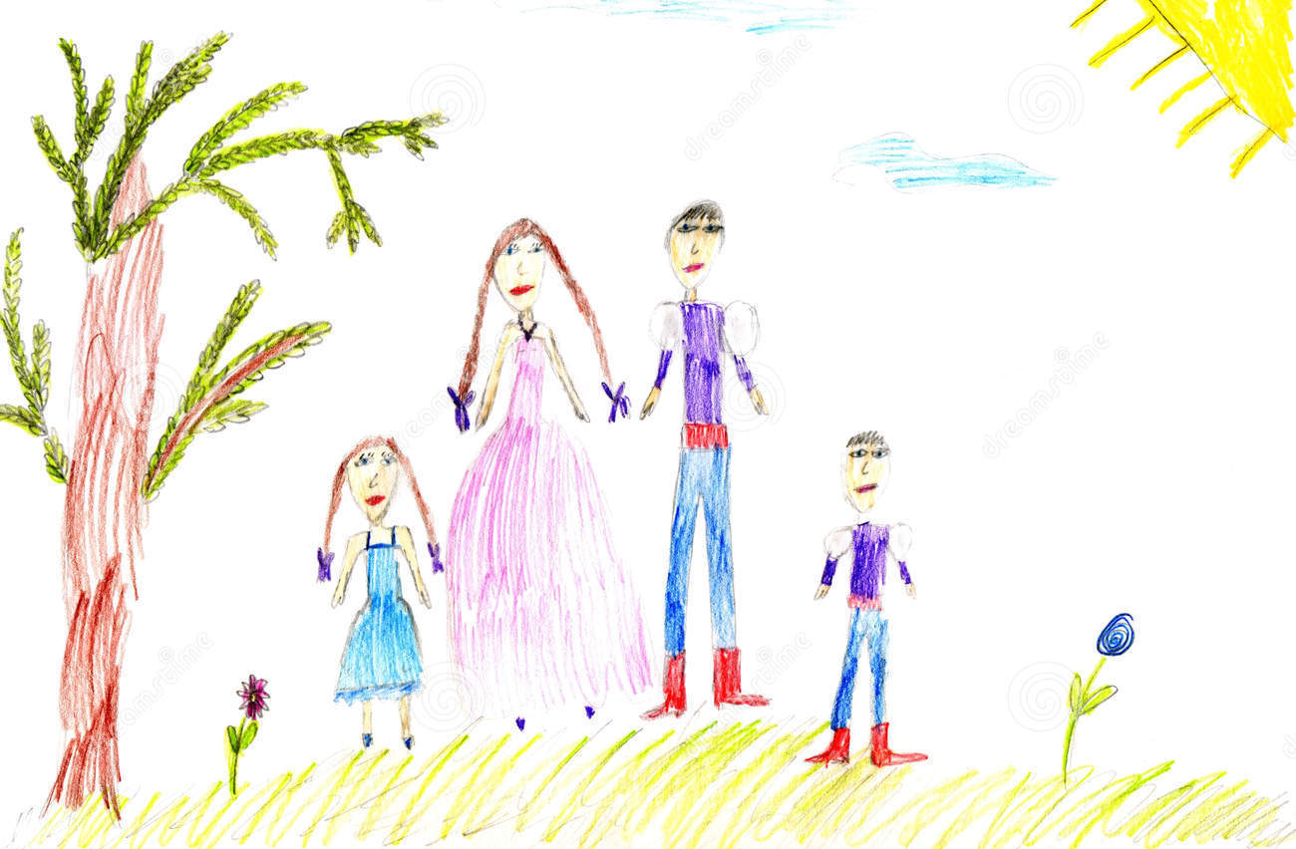
All about me
Draw some pictures to tell us about yourself and bring them in to show us.
1. Draw a picture of yourself and your family

Slide 9
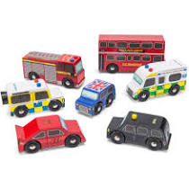
All about me
2. Draw a picture of your favourite book and toy

Slide 10
All about me
3. Draw a picture of what makes you happy and what you are looking forward to about school.

Slide 11
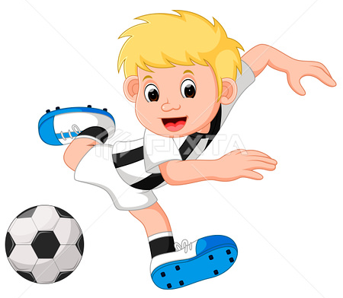
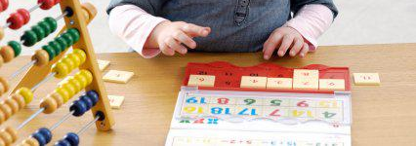
All about me
4. Draw a picture of what you are really good at and what you might need help with

Slide 12
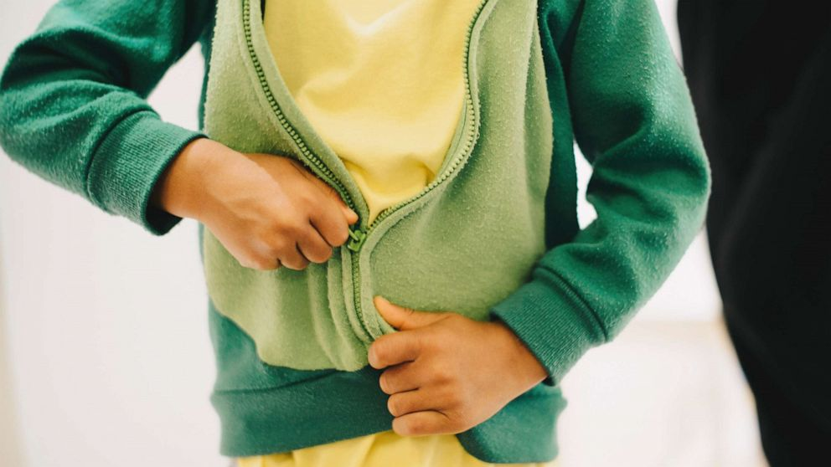
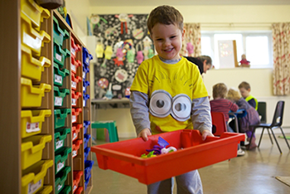
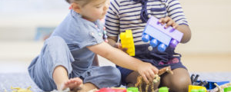
Things that will help me with starting school.
Getting ready to start school
I can put my coat on by myself and do the zip or button up
I can tidy up things that I have been playing with
I am getting better at concentrating when I am doing something I enjoy
I know how to share with my friends

Slide 13
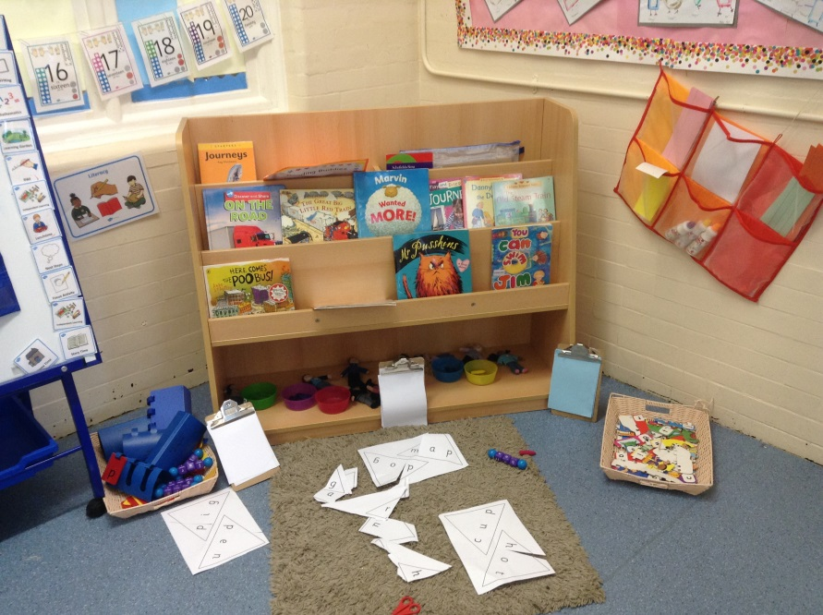
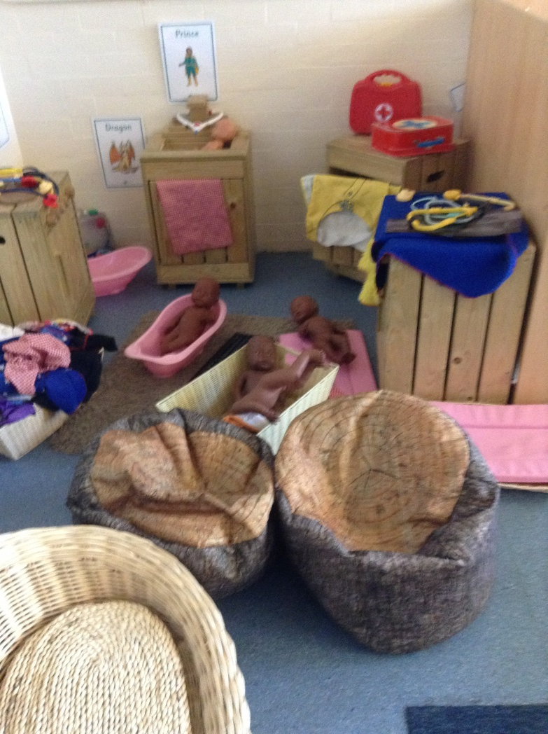
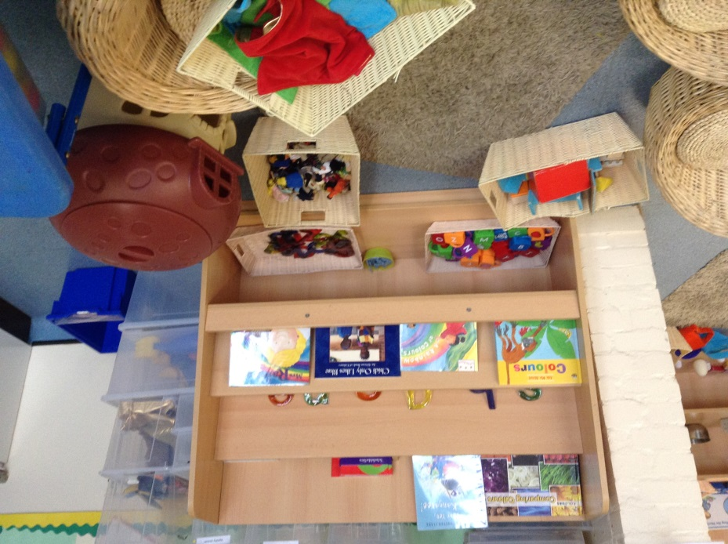
Your classroom will look like this

Slide 14
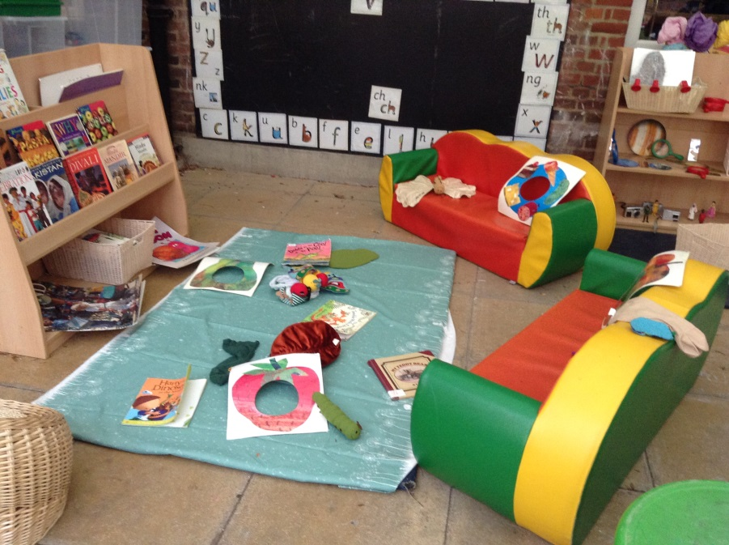
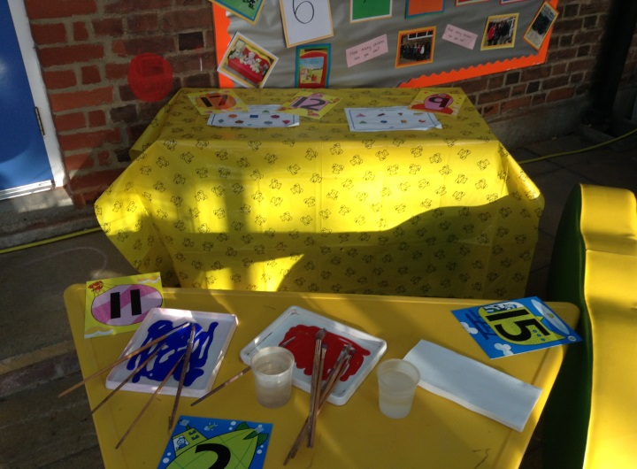
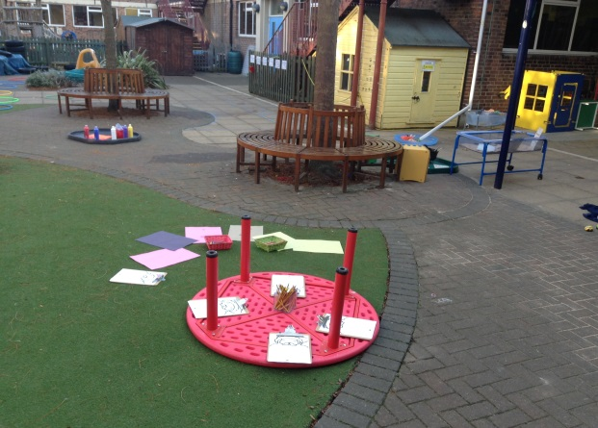
This is our learning garden where you will be able to play

