Slide 1
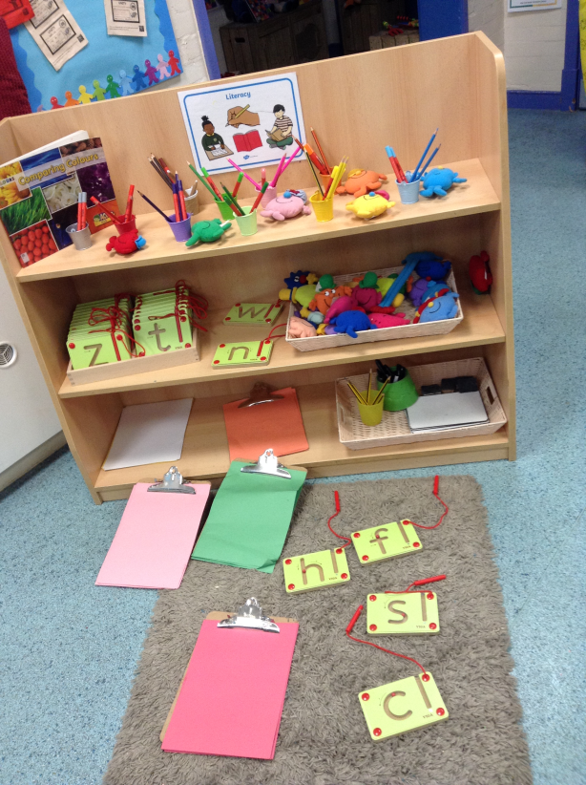
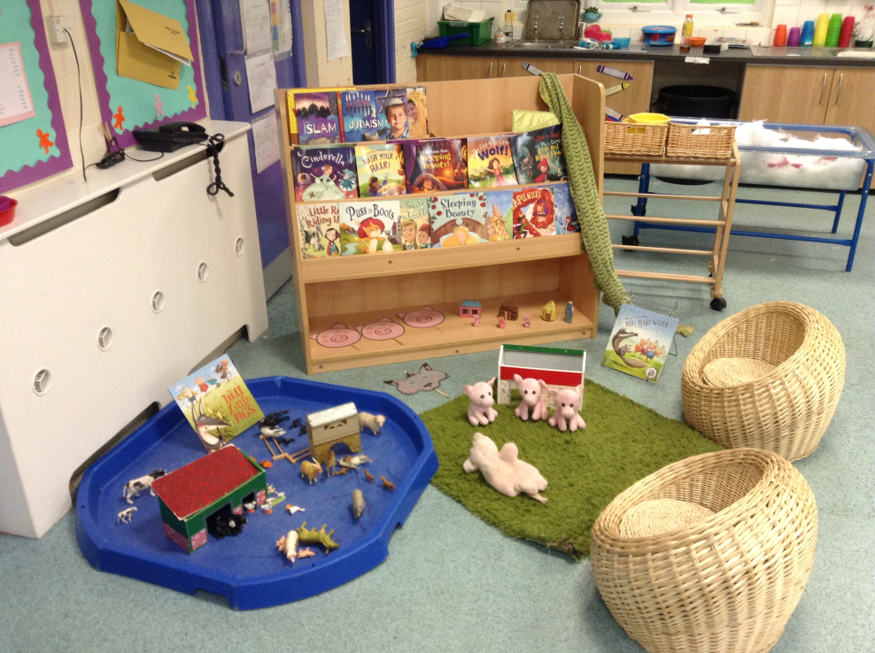
Welcome to Nursery

Slide 2
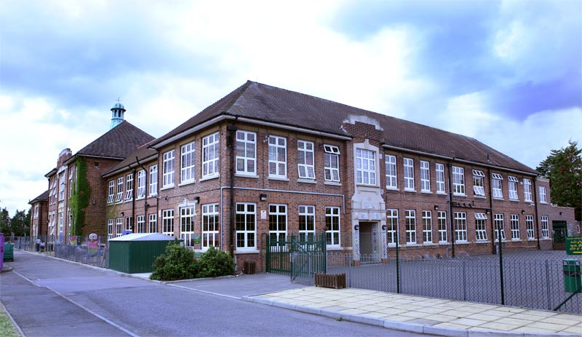
My school day
Nursery AM
School starts at 8.50am
We go home at 11.50pm

Slide 3
My school day
Nursery PM
School starts at 12.30pm
We go home at 3.30pm

Slide 4
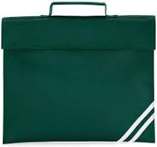
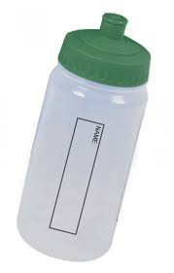
What do I need to bring?
A book bag
A water bottle with my name on
A sun hat in the summer
Gloves and a coat in the winter

Slide 5
Who will I meet?
Mrs Shamim
Class Teacher

Slide 6
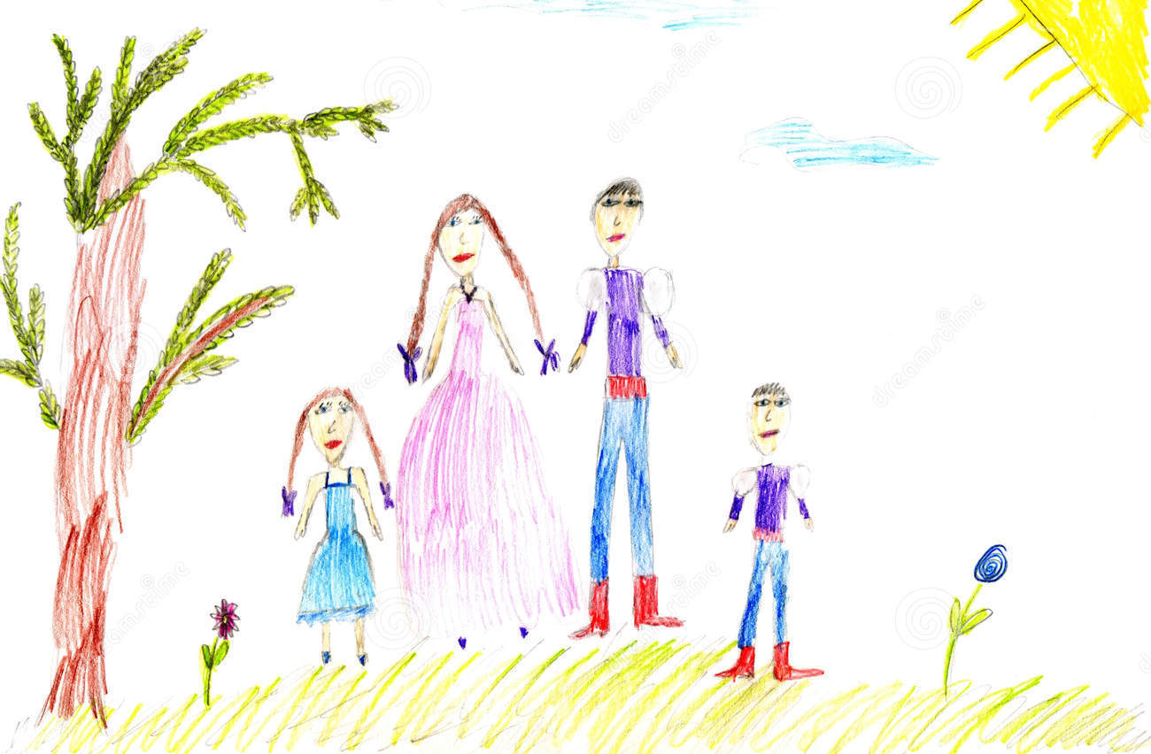
All about me
Draw some pictures to tell us about yourself and bring them in to show us.
1. Draw a picture of yourself and your family

Slide 7
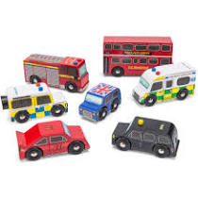
All about me
2. Draw a picture of your favourite book and toy

Slide 8
All about me
3. Draw a picture of what makes you happy and what you are looking forward to about school.

Slide 9
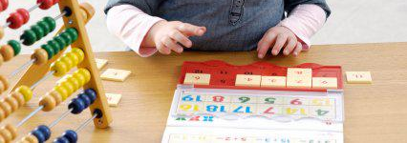
All about me
4. Draw a picture of what you are really good at and what you might need help with

Slide 10
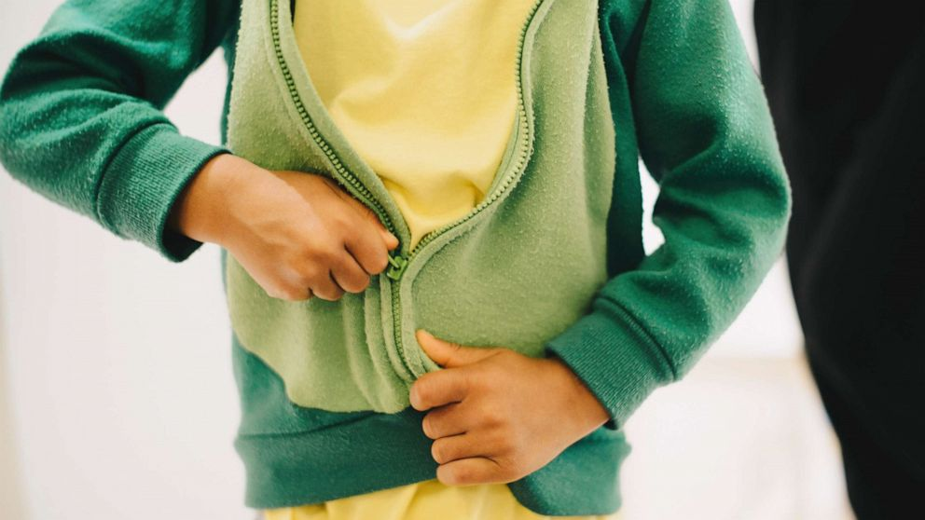
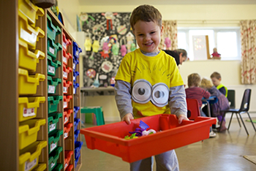
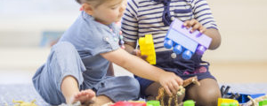
Things that will help me with starting school.
Getting ready to start school
I can put my coat on by myself and do the zip or button up
I can tidy up things that I have been playing with
I am getting better at concentrating when I am doing something I enjoy
I know how to share with my friends

Slide 11
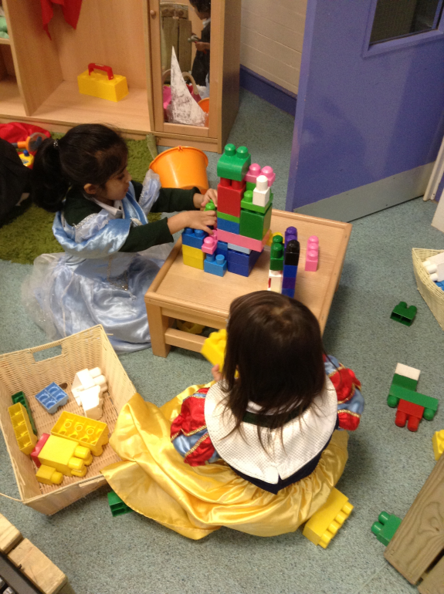
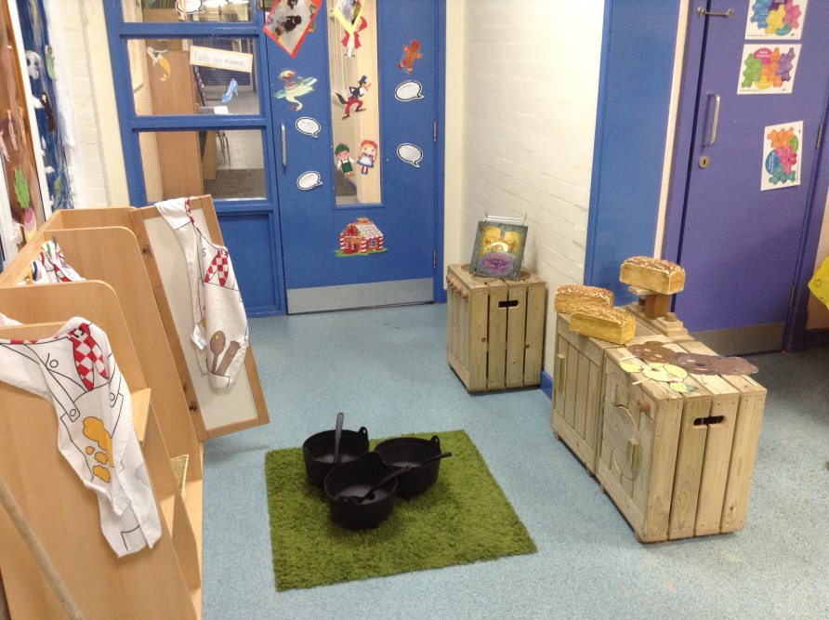
Your classroom will look like this

Slide 12
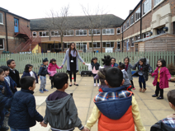
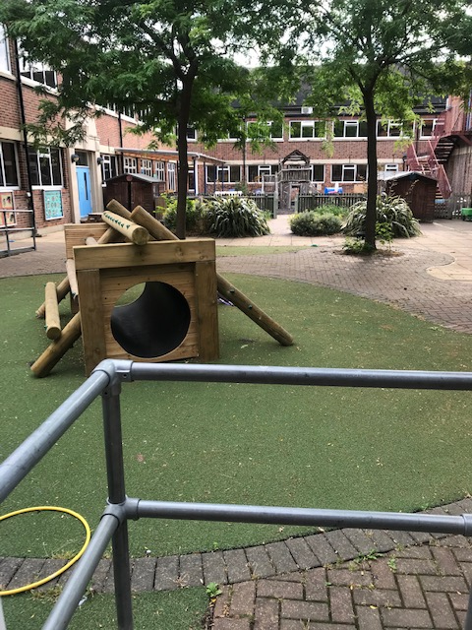
This is our learning garden where you will be able to play

Slide 13
We look forward to seeing you soon!

