Slide 1

Step Into
Secondary
Illustrations by Juli Dosad

Slide 2
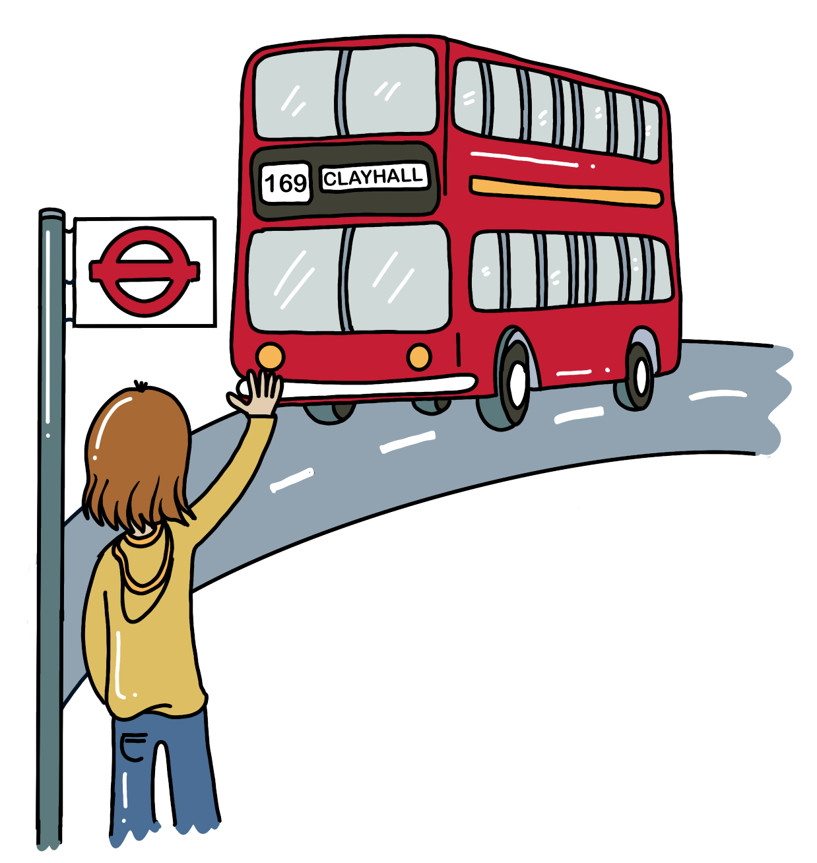
Starting the new chapter
Going to secondary school might mean you become a bit more independent – you might be taking the bus on your own, for example.
Being able to do more on your own is great, but you need to stay safe, and be kind to others.
Today, we’ll learn how to handle tricky situations!

Slide 3

Discuss with the person next to you
What are you looking forward to about secondary school?
What are things you feel less confident about?
Are there any tricky situations you are concerned about?

Slide 4

If you’re in a tricky situation, ask yourself…
Is what’s happening ok?
How do I feel?
How might the other people involved feel?
If you’re seeing someone in trouble - is it safe to step in?
Who could help me in this situation?
Who can I talk to about this?
It’s always okay to leave a situation that doesn’t feel safe!

Slide 5
Discuss with the person next to you
How can you tell when a situation is not safe?

Slide 6
Top tips for tricky situations
Always pay attention to what’s going on around you. Trust the little voice inside your head - if something feels wrong, it's likely because it is.
Be confident and stay true to your own beliefs and boundaries. That can mean saying ‘no’ or leaving a situation if you feel uncomfortable.
Everyone deserves to be treated with respect and kindness, online and in real life. Respecting others includes accepting a 'no'.
If you see someone else in a tricky situation and it’s safe, stand up for them or get help.
If something is bothering you, there are always people you can talk to, whether at school or at home.

Slide 7
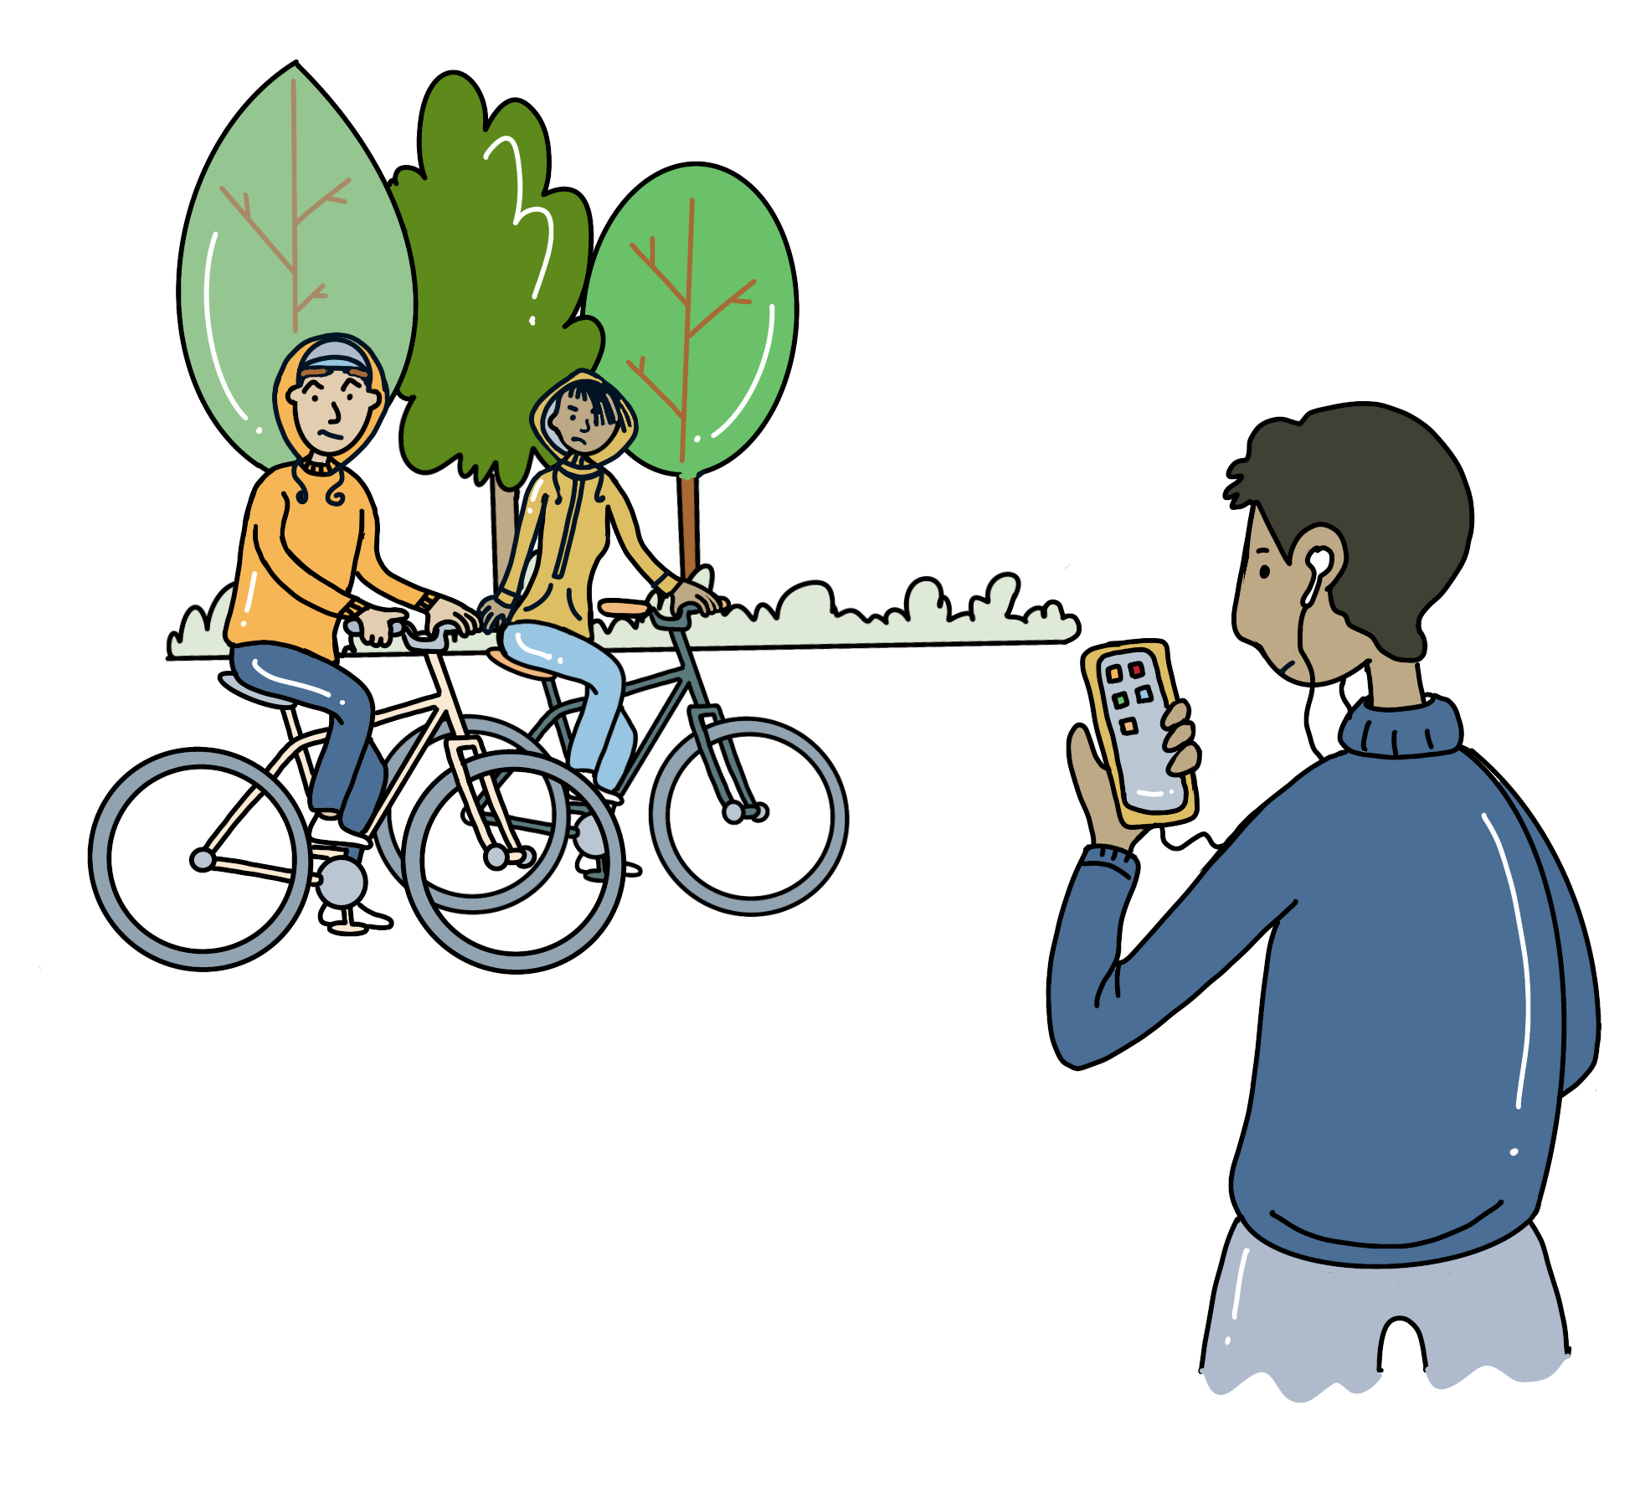
Practise - What would you do?
On the way home from school, you walk through a park and listen to music.
Two young people on bikes approach you and tell you to hand over your phone.

Slide 8
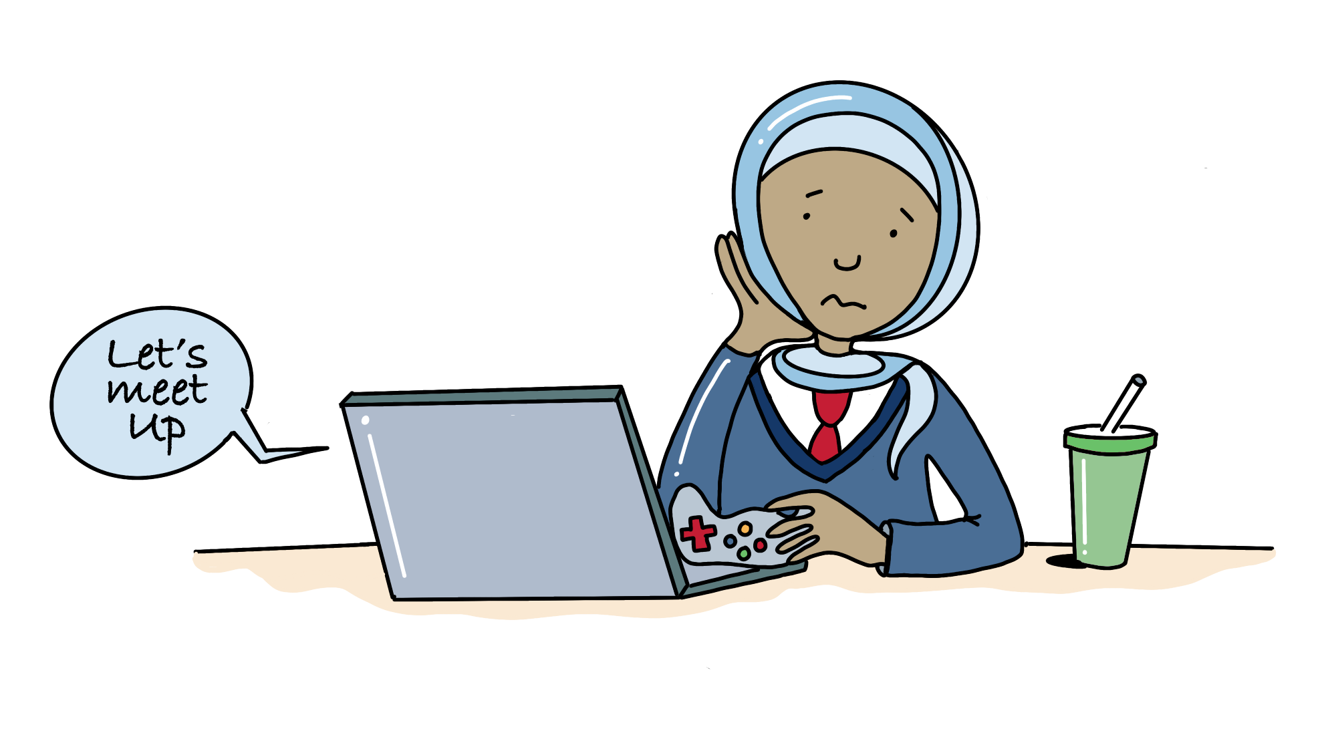
Practise - What would you do?
You have met someone online while gaming.
You’ve been chatting for weeks, and now they ask which school you go to, suggesting they will come by to meet you there tomorrow.

Slide 9
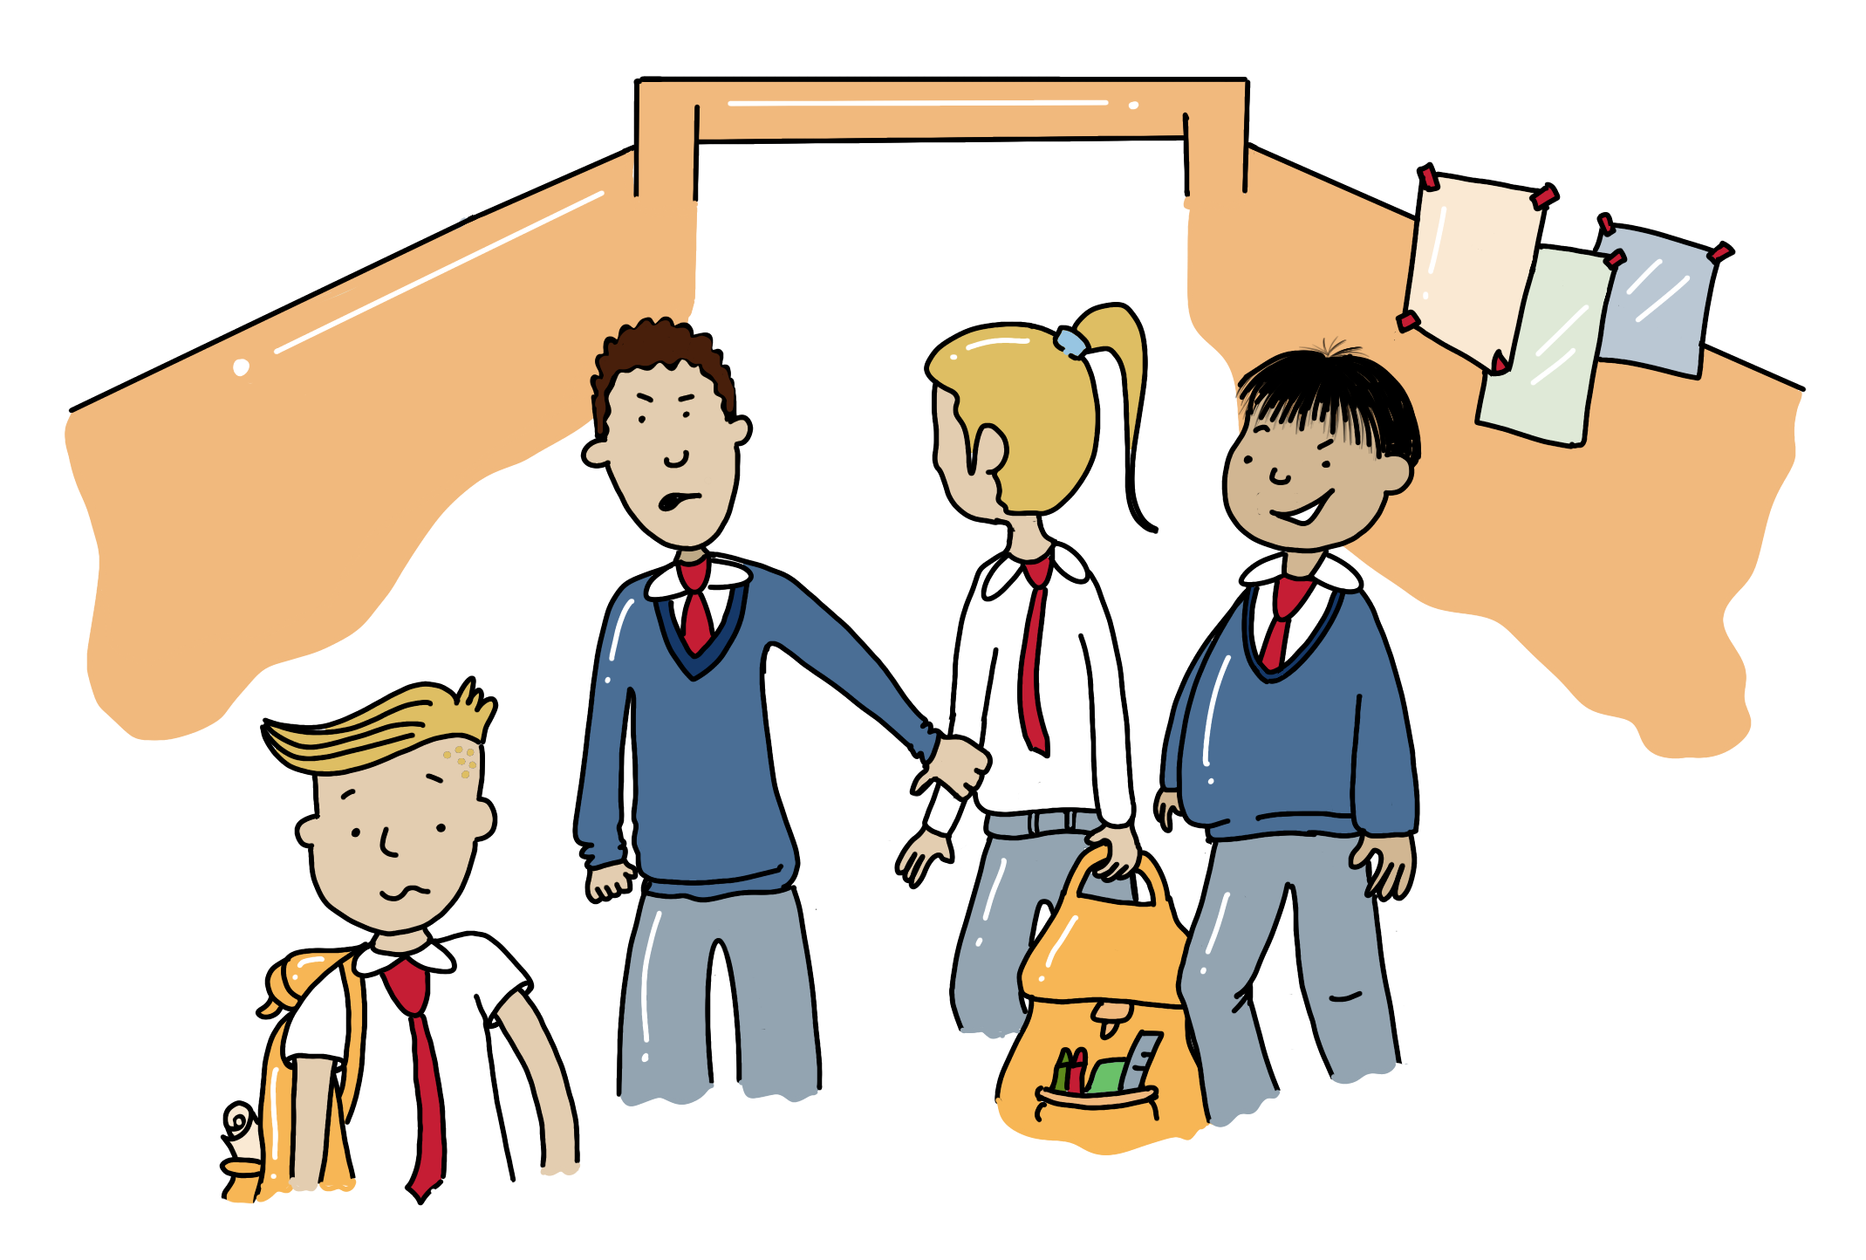
Practise - What would you do?
You see that a girl is being hassled by older boys in the corridor at school. She’s trying to leave, but they don’t let her go.

Slide 10
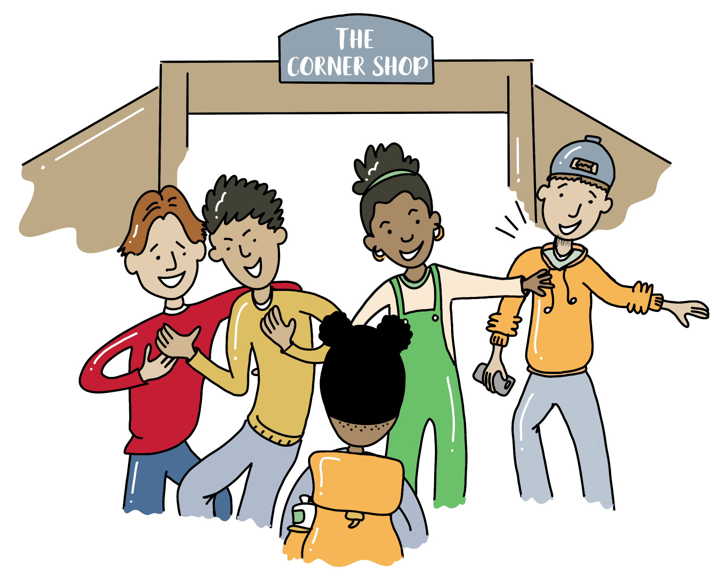
Practise - What would you do?
At the corner shop a group of older teenagers are hanging out laughing and pushing each other. When they see you, they say “hey, come here”.

Slide 11
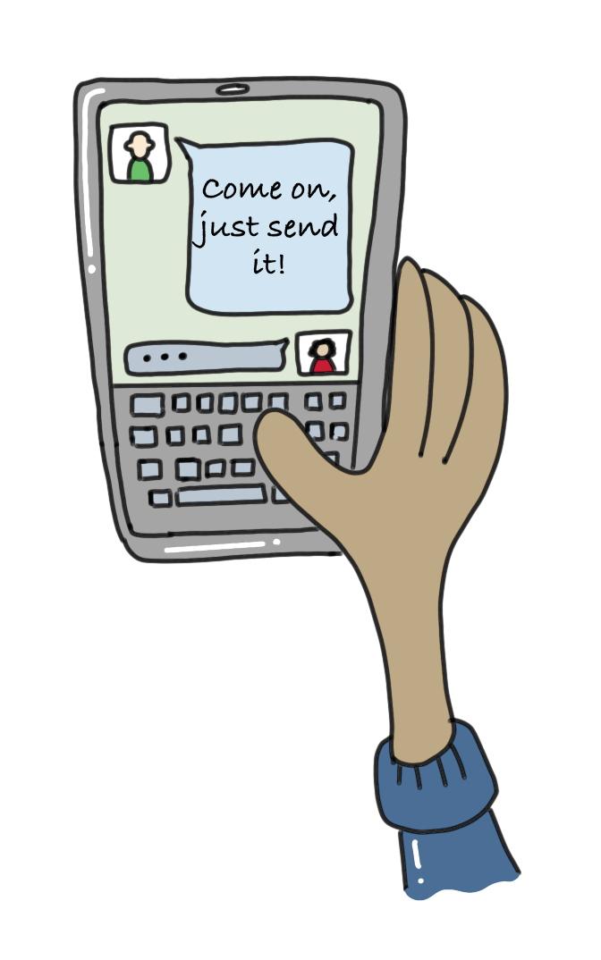
Practise - What would you do?
You’ve been sent a private photo by a classmate. Your friends are pressuring you to forward it to them, so they can see it, too.

Slide 12
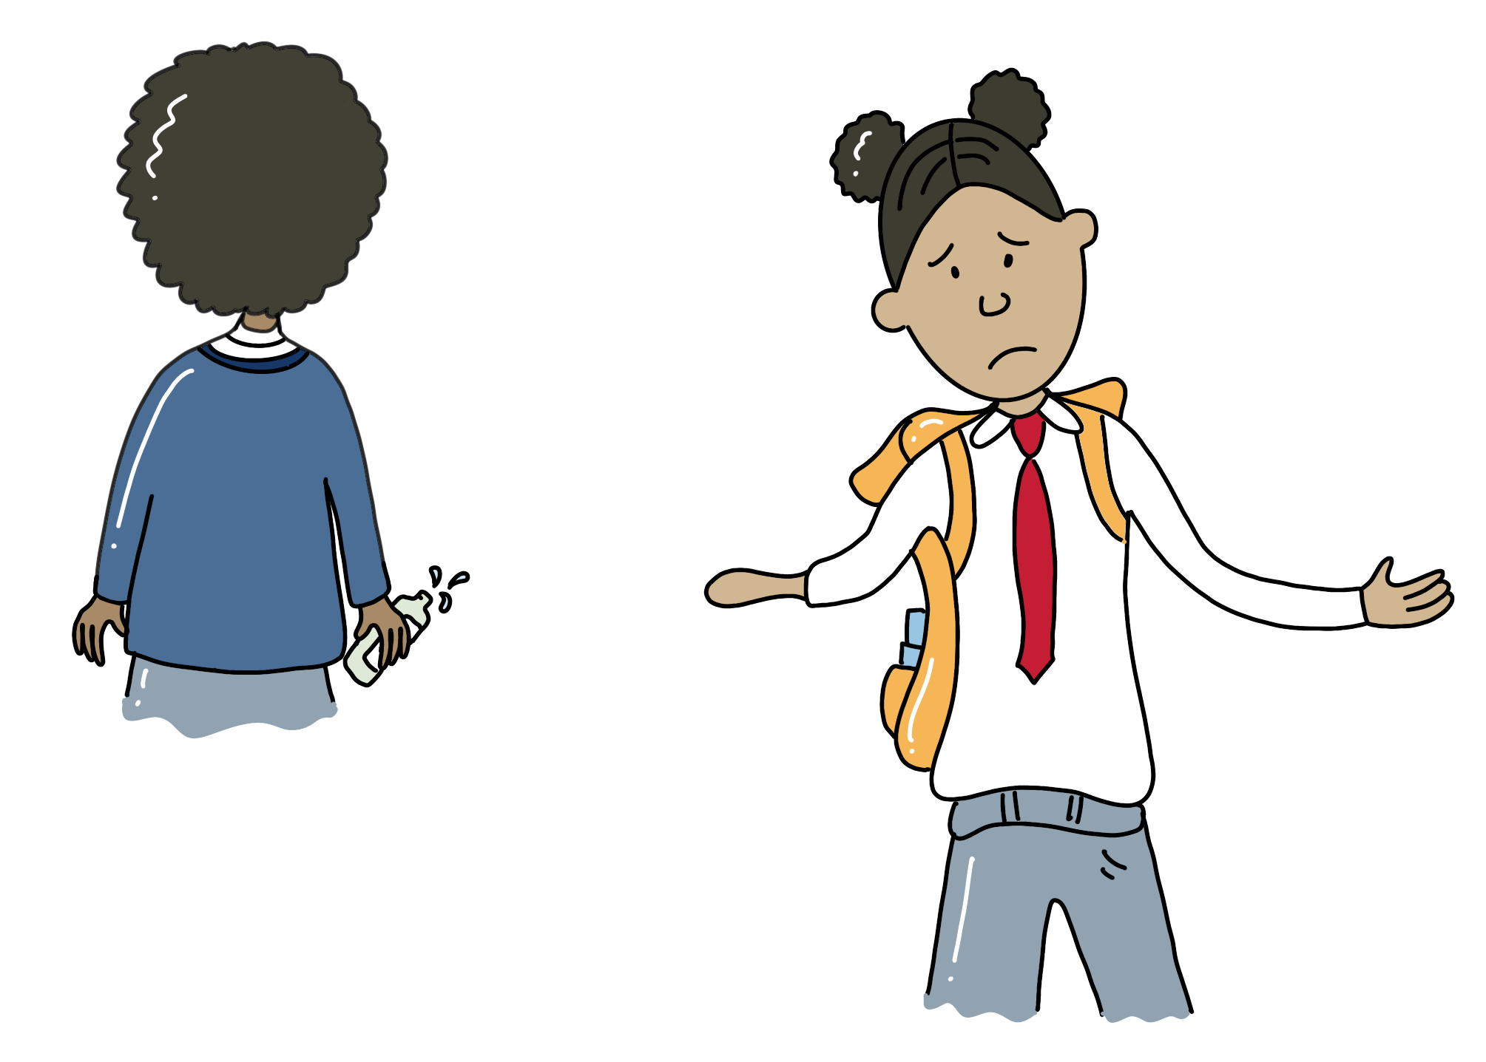
Practise - What would you do?
There is one person in your friendship group at school who you'd like to get to know better. You ask them if they'd like to watch a film next weekend but they say "no".

Slide 13
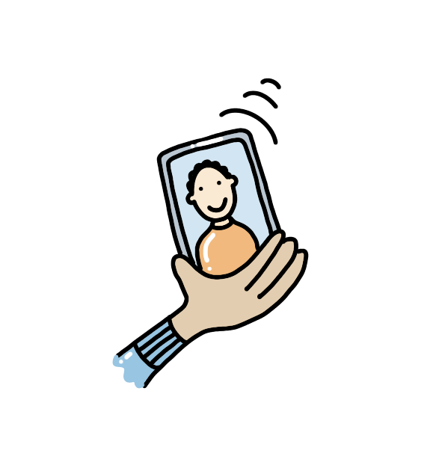
Getting support
In an emergency, always call 999.
Childline
A free 24-hour phone number and chat for children to get help for all kinds of personal issues.
0800 1111 www.childline.org.uk
Childnet
Advice for young people and parents on staying safe online.
www.childnet.com
YoungMinds
Mental health support for young people and information for parents.
www.youngminds.org.uk
There are trusted adults at your primary and at your secondary school who you can always talk to.
Make sure you have the phone numbers of some trusted adults in your bag, as well as your home address and phone number.

