Slide 1
Step Into Secondary
Illustrations by Juli Dosad

Slide 2
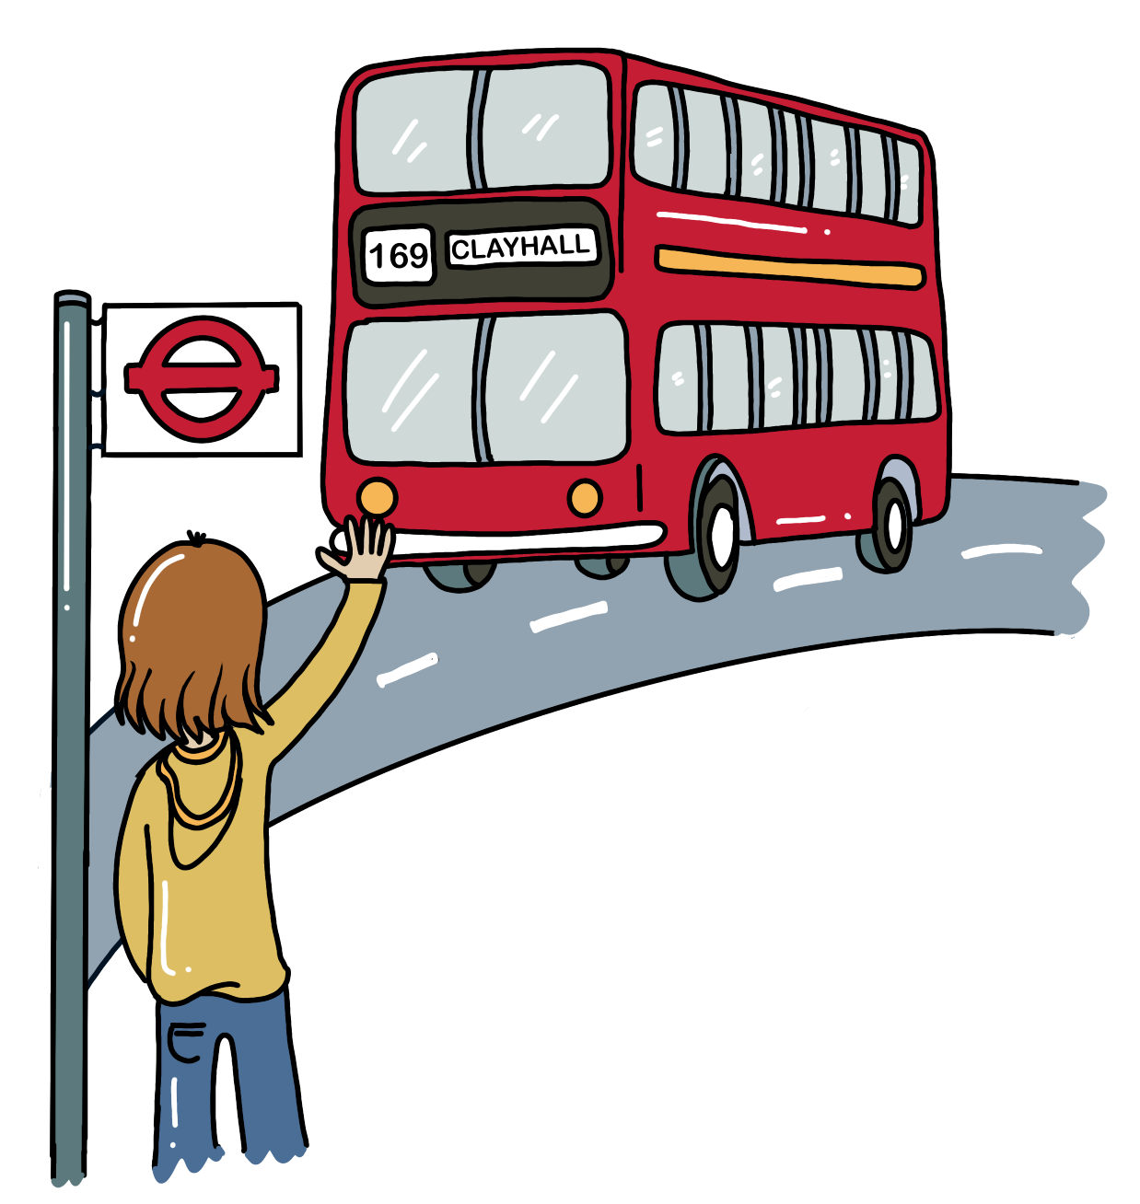
Starting the new chapter
Sending your kids to secondary school means some changes are happening and new challenges are on the horizon.
Your kids are becoming more independent – like taking the bus on their own, for example. That’s exciting, and we should encourage it.
At the same time, we have to make sure they have the skills to stay safe, to speak up if necessary, and to show kindness and respect to others.

Slide 3
Discuss with the person next to you
How do you feel about your child going to secondary school?
Do you have any worries about secondary school? If yes, what are they?

Slide 4
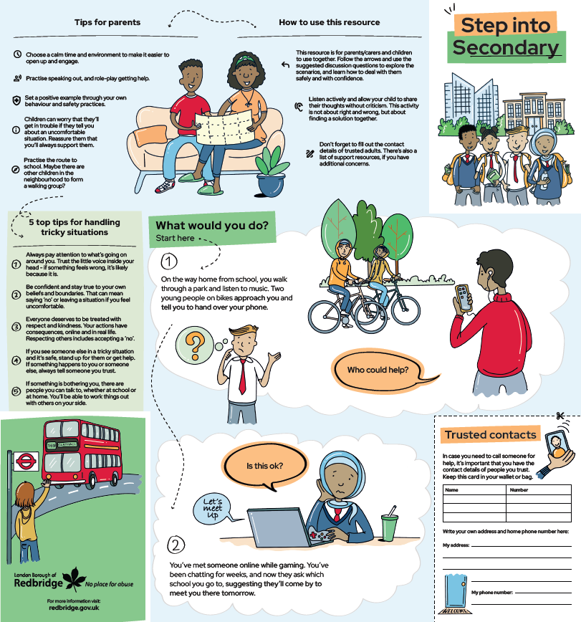
A new council resource
All Year 6 parents will receive this resource
It’s been designed with students, school staff and parents
Use it to talk through tricky scenarios with your child over the summer
Good preparation will make all the difference for a smooth transition!

Slide 5
Tips for parents to ensure a safe transition
Use the “Step Into Secondary” resource with your child at home over the holidays. Choose a calm time and environment to make it easier to open up and engage.
Practise speaking out, and role-play getting help.
Set a positive example through your own behaviour and safety practices.
Children can worry that they'll get in trouble if they tell you about an uncomfortable situation. Reassure them that you’ll always support them.
Practice the route to school. Maybe there are other children in the neighbourhood to form a walking group?

Slide 6
Messages to reinforce at home
Always pay attention to what’s going on around you. Trust the little voice inside your head - if something feels wrong, it's likely because it is.
Be confident and stay true to your own beliefs and boundaries. That can mean saying ‘no’ or leaving a situation if you feel uncomfortable.
Everyone deserves to be treated with respect and kindness, online and in real life. Respecting others includes accepting a 'no'.
If you see someone else in a tricky situation and it’s safe, stand up for them or get help.
If something is bothering you, there are always people you can talk to, whether at school or at home.

Slide 7
Getting support
In an emergency, always call 999.
YoungMinds
Mental health support for young people and information for parents.
www.youngminds.org.uk
Childnet
Advice for young people and parents on staying safe online.
www.childnet.com
Childline
A free 24-hour phone number and chat for children to get help for all kinds of personal issues.
0800 1111 www.childline.org.uk
There are trusted adults at your primary and at your secondary school who children can always talk to.
Make sure your child has the phone numbers of some trusted adults in their bag, as well as their home address and phone number.

Slide 8
Any questions?

