Slide 1


Year 6
Information for parents

Slide 2
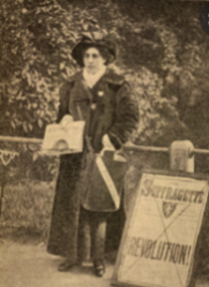
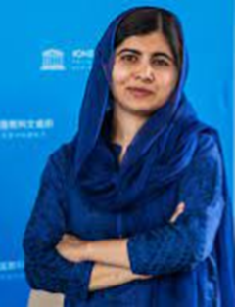
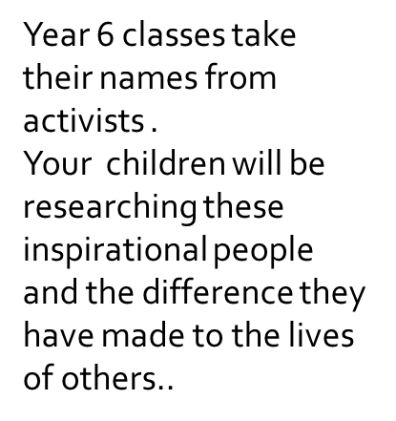
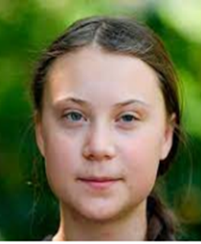
Year 6
Singh class- Mrs Dhadwal
Yousafzai class- Mrs Murphy/Mr Radmore
Thunberg class- Mr Lawless

Slide 3
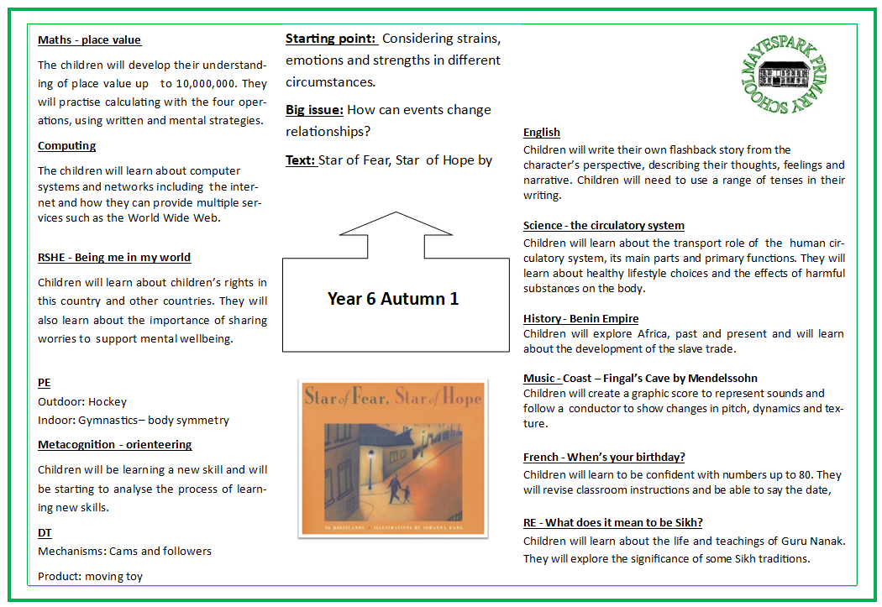
Curriculum
Each half term you will receive an overview outlining what your child will be learning in school.
You may want to visit the library to research some of the topics we will be covering.

Slide 4
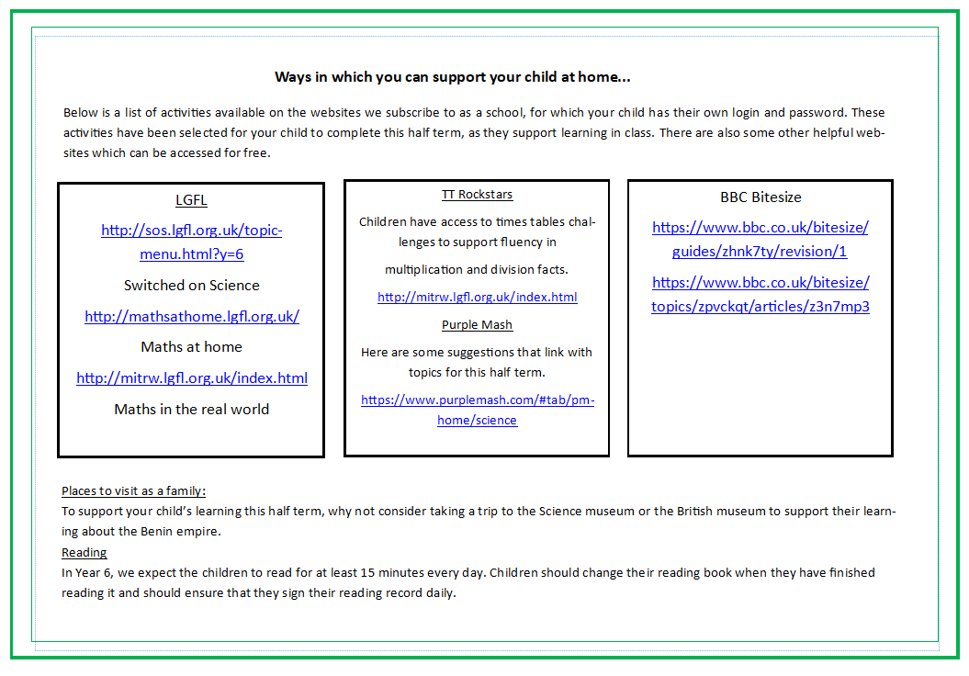
Curriculum
The overview will also include ideas for learning at home and places to visit to support the curriculum.
SPAG.com
https://www.spag.com/
Mymaths
https://www.mymaths.co.uk/
In Year 6, we expect the children to read for at least 30 minutes every day. Children should change their reading book when they have finished reading it and should ensure that they sign their reading record daily.

Slide 5
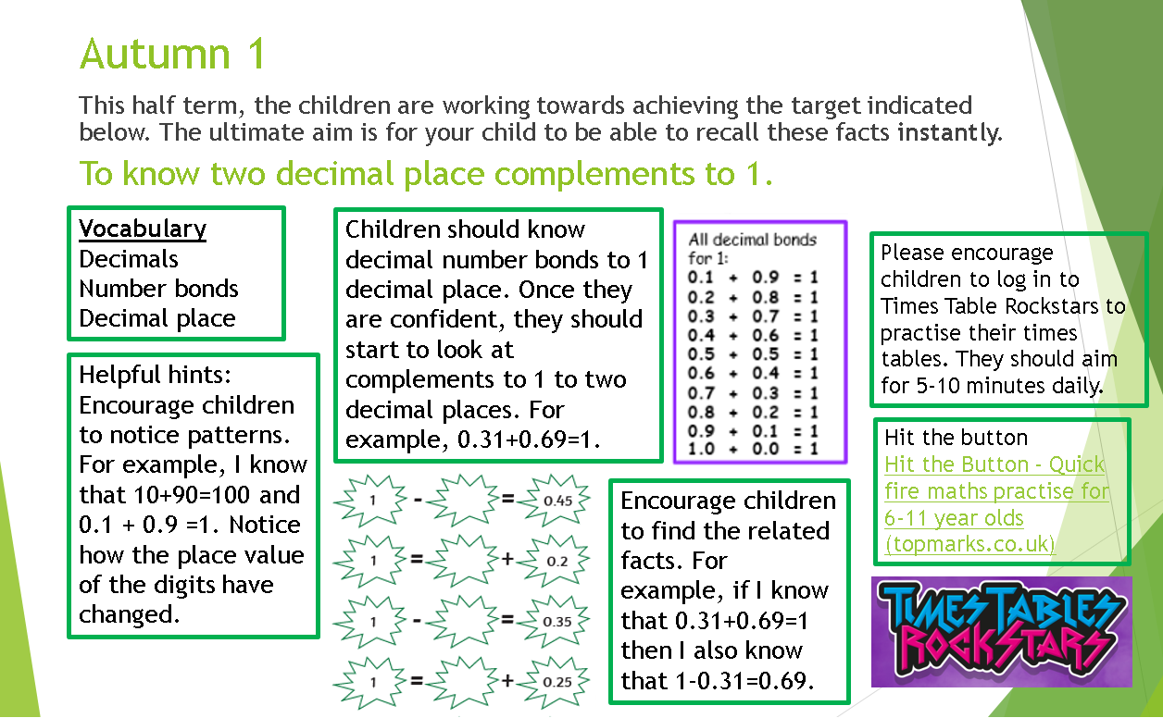
Key Instant Recall Facts
You will also receive information about key facts children will be learning in maths.
These will be facts that are useful for children to learn and be able to recall fluently.

Slide 6
Educational visits
Below are some of the visits we hope to take part in, others may be included. Further information will follow once dates are confirmed.
Term | Visit
Autumn | Gurdwara
Spring | The Globe
Summer | Southend

Slide 7

Reading expectations
It is vital that children read regularly at home so below are the expectations for this. We are very grateful for the support you give your children and we would ask that you continue as it is important we work together to continue to develop your children’s enjoyment of reading as well as their comprehension skills.
Children should read at home at least six times a week for 30 minutes.
Once your child is a free reader, they can write in their reading record themselves. An adult must still sign it once a week.
Children are responsible for changing their reading book when they have finished it.
Reading records will be checked daily in school so please ensure that your child has read at home.

Slide 8

Reading at home
Recommended reading lists can be found on the Mayespark website.
Children will also visit the local library with their class each half term.
You can also visit the library to access a broader variety of books for free.

Slide 9
Year 6 SATs
At the end of Key Stage 2, in year 6, children are assessed in reading, maths, spelling, punctuation and grammar, as part of the statutory requirements set by the Government.
This will be taking place the week beginning 12th May 2025
We will arrange a meeting with parents nearer the time.

Slide 10
Secondary school transition
Applications must be made online through the Redbridge Council website. Full guidance is given on the criteria for applications to schools. Please make sure that you apply by the final deadline as stated below.
If you have questions about this process please ask at the school office and we will support you with this.
The application process opened on 1 September 2024
The deadline for online applications is 31 October 2024

Slide 11
Homework
Homework is set weekly.
Children will receive Maths and English homework, including spellings. Homework will be related to what has been taught in school that week.
Homework is set on Google Classroom on Friday.
Homework should be returned by the following Wednesday.
Spelling tests will be on Fridays.
Please contact your class teacher via the school office if you are experiencing difficulties accessing homework.

Slide 12
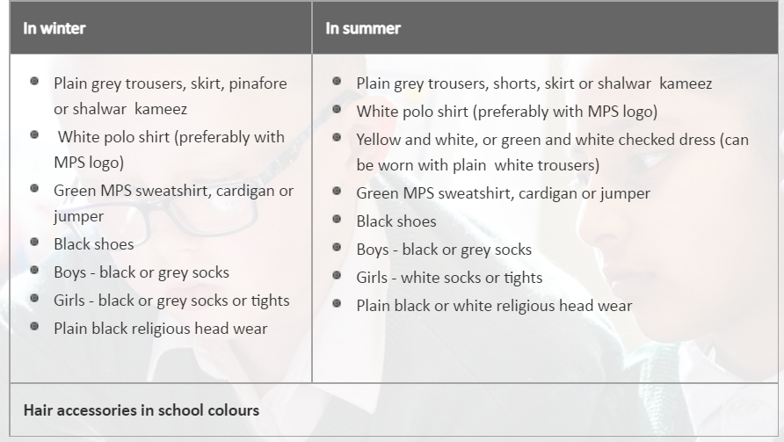
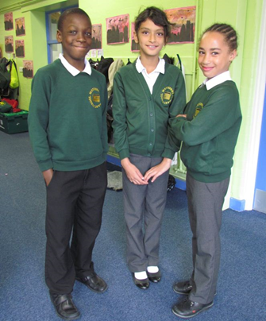
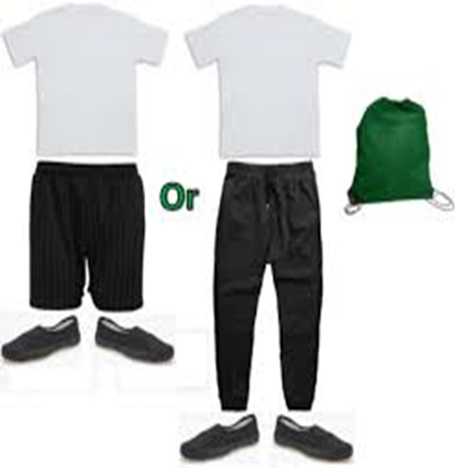
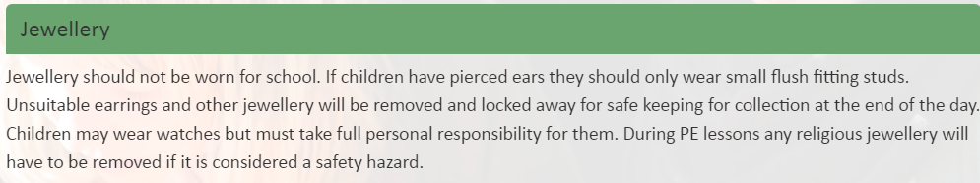
Uniform expectations
Please ensure PE kits are in school everyday and all uniform has your child’s name on it.

Slide 13
Communication
Class teachers are always happy to help with any queries.
Please contact the office via email or call to arrange an appointment.
Translation is available for any parents who need this support.
Parents’ Evening dates will be available on the school calendar.
Please remember to check you emails and look at the parent app regularly.
Phone: 02085992263 (please leave a message and we will return your call out of teaching hours)
EMAIL: office@mayespark.redbridge.sch.uk
We look forward to your support and cooperation in making this academic year a memorable and successful experience for your child.

