Slide 1
Read Write Inc. Phonics
Parents’ Meeting

Slide 2
Teach a child to read
and keep that child reading [and talking]
and we will change everything.
And I mean everything.
Jeanette Winterson

Slide 3
Who is Read Write Inc. Phonics for?
Notes:
Read question.

Slide 4
Read Write Inc. Phonics
Nursery – Year 2
Older children who need to‘catch-up’
Children new to English

Slide 5
What is Read Write Inc. Phonics?

Slide 6

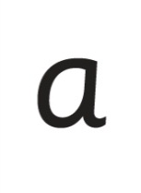

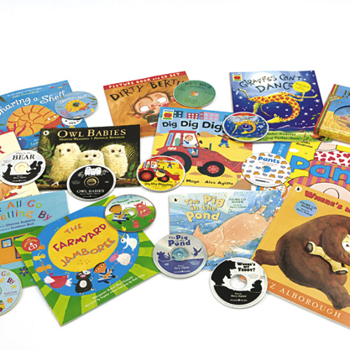




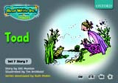
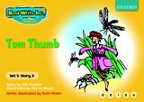
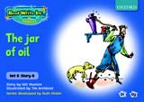
Systematic approach
sat
Then we teach children how to blend the sounds together to read words
mat
p
First we teach sounds in a specific order
sad
d
i
t
n
The children read words in the matched Storybooks. These are matched to the sounds they can read so they are set up to succeed.
We read to children ‘real books’ Once they can read they can independently read these books for themselves.

Slide 7
English alphabetic code
In English we have more than 150 ways to represent 44 sounds, using the 26 letters in the alphabet.
This means we have to group letters together to write some sounds e.g. ‘igh’
One of the most complex alphabetic codes in the world.

Slide 8
Pure Sounds
We teach using pure sounds.
We use pure sounds (‘m’ not’ muh’, ’s’ not ‘suh’, etc.) so that your child will be able to blend the sounds into words more easily.
Children need to know sounds – not letter names – to read words.
This video of Sylvie demonstrates how to talk in pure sounds.
https://www.youtube.com/watch?v=TkXcabDUg7Q

Slide 9
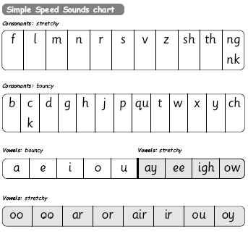
Simple Speed Sounds
Phonics makes learning to read easy for children because we start by teaching them just one way of reading and writing every sound.
Here they are on the Simple Speed Sounds chart.
We teach Set 1 sounds first - (sounds as far as a e i o u) and then Set 2 (the shaded sounds ay - oy).

Slide 10
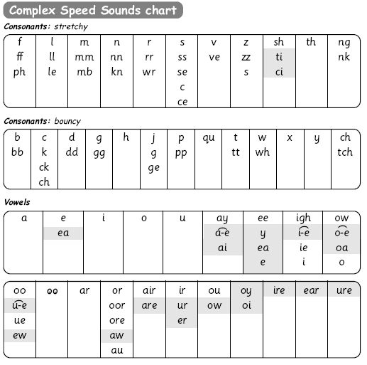
Speed Sounds chart
We use this Speed Sounds chart in Phonics lessons.
It shows the most common graphemes for each sound.
Each box is a sound box showing different ways to read and write the sound.

Slide 11
How does Read Write Inc. use phonics to teach reading?
Notes:
Read question.

Slide 12
Blending using Fred Talk
Once the children know the pure sounds, we teach them to blend sounds to read words. We also teach children to spell the words they learn to read.
We use Fred Talk to help children read and spell words.
p
sat
d
mat
i
t
sad

Slide 13
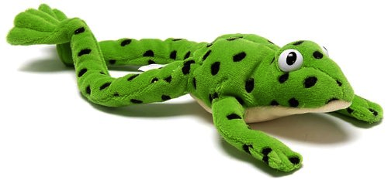
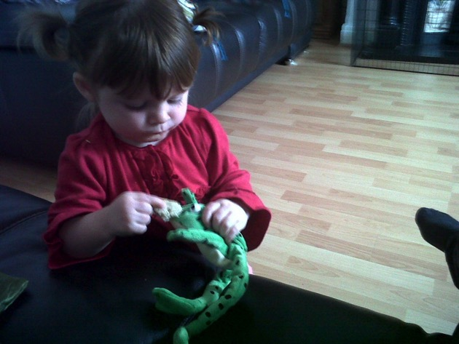
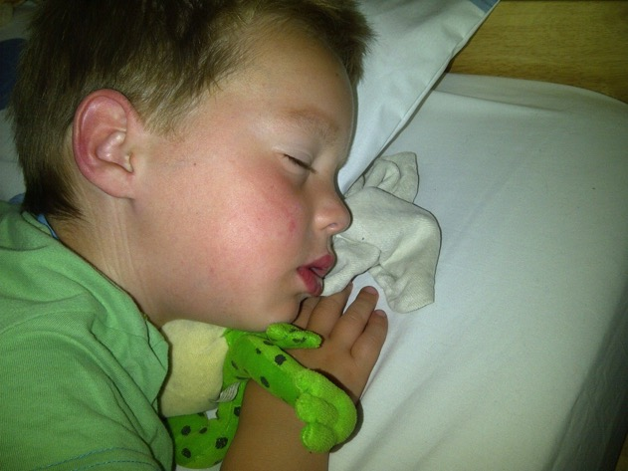
Fred Talk
This is Fred.
He is a frog who can only speak in sounds, and we call this Fred Talk. For example ‘m’ ‘a’ ‘t’, ‘l’ ‘u’ ‘n’ ‘c’ ‘h’.
He helps children sound out words so they can read and spell.

Slide 14
Storybooks
Alongside learning each set of sounds, they read Storybooks that only contain the sounds and words they can read. This sets them up to succeed in their reading.
We discuss and write about the ideas in these Storybooks.
We also teach children to read common exception words – words like ‘said’ and ‘they’.

Slide 15
How does Read Write Inc. teach spelling?
Notes:
Read question.

Slide 16

Fred Fingers
We use Fred Fingers to help children sound out words to spell easily.
It means they do not have to memorise lists of spelling words.
It is a tool so they will be able to spell any word.
Notes:
.

Slide 17
What should my child read at home?
Notes:
Read question.

Slide 18
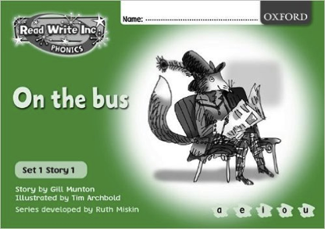
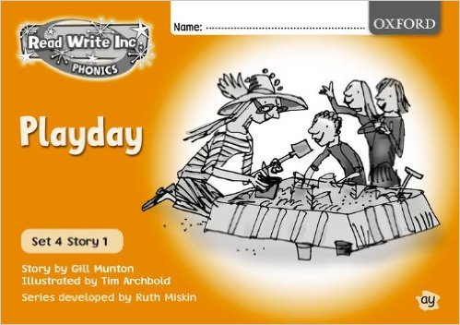

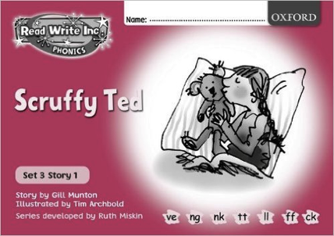
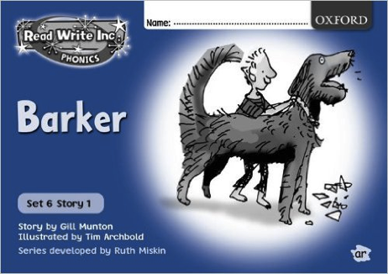
Read Write Inc. Storybooks
Storybooks/ black and white paper versions of the Storybooks will be sent home for your children to read.
They will know all of the sounds used in the Storybook as they will bring home the book that they have already read three times in the classroom.
This means they will be able to read the text with fluency and confidence – like a storyteller. They will enjoy reading to you.
This does not mean the text is too easy for them – it means they are reading at the correct level.

Slide 19

Read Write Inc. Storybooks
Children will also bring home a ‘BOOK BAG book’. This is a book the child will not have read at school but is at the same level as the class book they have been reading. This gives them the opportunity to practice reading an unfamiliar book that includes sound that they have learnt at school. Inside the books they are set out like the books the children have read in class so the children will be able to practice their green words, red words as well as answer questions about the story.

Slide 20
How can I help at home?
Notes:
Read question.

Slide 21
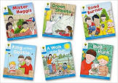

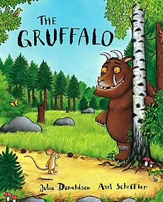


Banded books and picture books
Notes:
Reception - They will also bring home a picture book to share and enjoy with you at home.
Year 1 and 2 – book banded book
This book has already been read to the class in school so they will care about the story and love hearing the story again and again.

Slide 22
Storytime
Read to your children
One of the most important things you can do as a parent at home is read higher level texts to your child.
This helps develop an enjoyment for stories and the motivation for learning to read themselves.
Ask lots of questions and share opinions

Slide 23
Read Write Inc. lessons
It really helps to be aware of how your child is learning in the classroom.
Pure sounds – not letter names
Fred Talk – to read words
Fred Fingers – to spell words
Encourage your child to discuss their Phonics lessons with you and to read and discuss their storybook with you at home.

Slide 24
Online resources available
There are some online resources and videos to help you.
Pronunciation guide and other videos:
http://www.ruthmiskin.com/parents
https://www.youtube.com/watch?v=TkXcabDUg7Q
Learning videos:
https://www.mayesparkprimaryschool.org.uk/learning/support-for-parents
Free e-books for home reading:
http://www.oxfordowl.co.uk/reading/

Slide 25
Reading feeds the imagination, it expands
horizons and offers new and exciting ways of
seeing and making sense of our lives and of
the world around us.
Michael Morpurgo

