Slide 1
Read Write Inc. Phonics Parents’ Meeting for RECEPTION

Slide 2
Jeanette Winterson
“Teach a child to read…keep that child reading and we will change everything”

Slide 3
Who is Read Write Inc. Phonics for?
Notes:
Read question.

Slide 4
Read Write Inc. Phonics
Nursery – Year 2
Older children who need to‘catch-up’
Children new to English

Slide 5
Why Phonics?
A complete literacy programme - systematic and structured.
Meets the demands of the national curriculum, giving your children the best chance of success.
Starting at the beginning...Early Years
Read storybooks and non-fiction books closely matched to their developing phonic knowledge
Read with fluency and expression
Learn to spell using known sounds
Write confidently by practising what they want to write out loud first
Work well with a partner

Slide 6
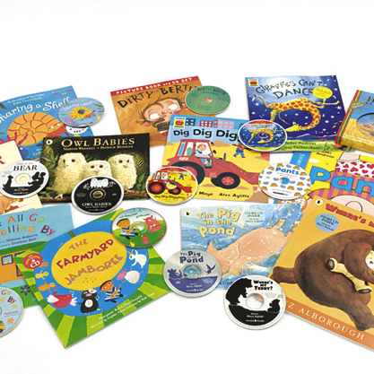
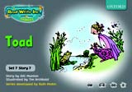
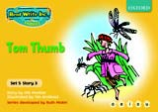
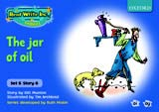
Systematic approach
sat
Then we teach children how to blend the sounds together to read words
mat
p
First we teach sounds in a specific order
sad
d
i
t
n
The children read words in the matched Storybooks. These are matched to the sounds they can read so they are set up to succeed.
We read to children ‘real books’ Once they can read they can independently read these books for themselves.

Slide 7
Language Development
Spanish
24 speech sounds
26 letters to make up those sounds
29 graphemes
English
speech sounds
letters to make up those sounds
graphemes
44
26
150+
eg. 9 different ways to write ‘or’ !!!
One of the most complex alphabetic codes in the world.

Slide 8
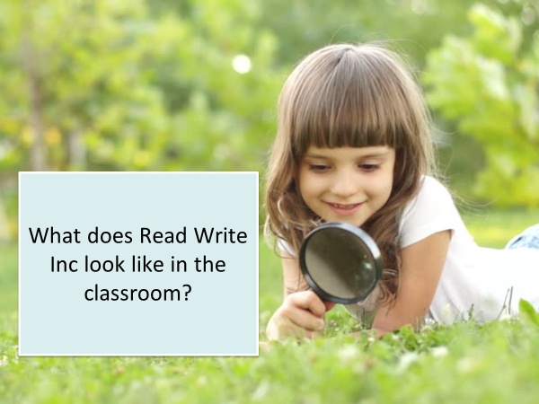
What does Read Write Inc look like in the classroom?

Slide 9
Simple Speed Sounds
Phonics makes learning to read easy for children because we start by teaching them just one way of reading and writing every sound.
Here they are on the Simple Speed Sounds chart.
2 letters that make one sound are called ‘special friends’

Slide 10
Pure Sounds
We teach using pure sounds.
We use pure sounds (‘m’ not’ muh’, ’s’ not ‘suh’, etc.) so that your child will be able to blend the sounds into words more easily.
Children need to know sounds – not letter names – to read words.
This video of Sylvie demonstrates how to talk in pure sounds.
https://www.youtube.com/watch?v=TkXcabDUg7Q

Slide 11
How does Read Write Inc. use phonics to teach reading?
Notes:
Read question.

Slide 12
Blending using Fred Talk
Once the children know the pure sounds, we teach them to blend sounds to read words. We also teach children to spell the words they learn to read.
We use Fred Talk to help children read and spell words.
p
sat
d
mat
i
t
sad

Slide 13
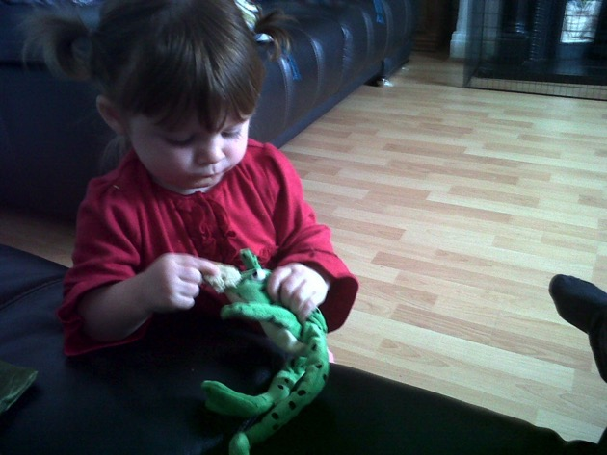
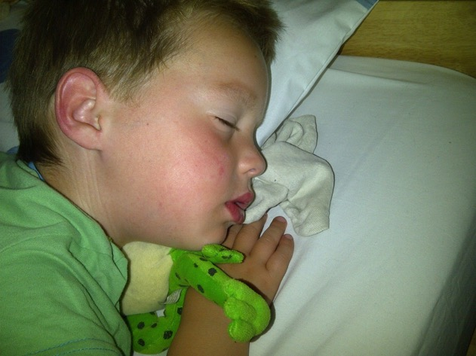
Fred Talk
This is Fred.
He is a frog who can only speak in sounds, and we call this Fred Talk. For example ‘m’ ‘a’ ‘t’, ‘l’ ‘u’ ‘n’ ‘c’ ‘h’.
He helps children sound out words so they can read and spell.

Slide 14
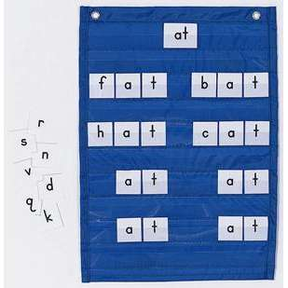
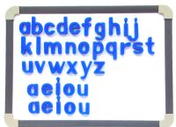
Learning to blend and segment with the sounds we know…
Assisted blending
as soon as the first 5
sounds are learnt!
Moving towards
independent
blending
Fred Fingers for spelling
*Say the word and
pinch on the sounds
Eyes for reading,
fingers for spelling!
a
c
t

Slide 15
Learning to blend and segment with the sounds we know…
Green words – contain all the sounds we know
*Fred talk
*Fred in your head
*No Fred talk
Red words
‘You can’t red a Fred’

Slide 16
How can I help at home?
Notes:
Read question.

Slide 17
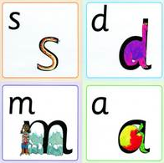
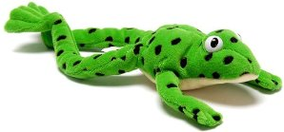
Reading stories at home Read favourite stories over and over again Read some stories at a higher level than they can read themselves. Listen to them reading their take home Phonics storybooks.
Practice pronouncing the sounds…
Remember no ‘fuh’ and ‘luh’!
Have fun with Fred Talk!
“What a tidy r-oo-m!”
“Where’s your c-oa-t?”
“Time for b-e-d!”

Slide 18
What should my child read at home?
Notes:
Read question.

Slide 19
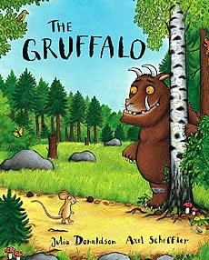
Picture books
The children will all bring home 2 library books per week. Please read and share these books with your children.
Notes:
Reception - They will also bring home a picture book to share and enjoy with you at home.
Year 1 and 2 – book banded book
This book has already been read to the class in school so they will care about the story and love hearing the story again and again.

Slide 20
Storytime
Read to your children
One of the most important things you can do as a parent at home is read higher level texts to your child.
This helps develop an enjoyment for stories and the motivation for learning to read themselves.
Ask lots of questions and share opinions

Slide 21
Online resources available
There are some online resources and videos to help you.
Pronunciation guide and other videos:
http://www.ruthmiskin.com/parents
https://www.youtube.com/watch?v=TkXcabDUg7Q
https://home.oxfordowl.co.uk/reading/reading-schemes-oxford-levels/read-write-inc-phonics-guide/
Learning videos:
https://www.mayesparkprimaryschool.org.uk/learning/support-for-parents
Free e-books for home reading:
http://www.oxfordowl.co.uk/reading/

Slide 22
Reading feeds the imagination, it expands
horizons and offers new and exciting ways of
seeing and making sense of our lives and of
the world around us.
Michael Morpurgo

